Slide 1
Smart Control Systems

Slide 2
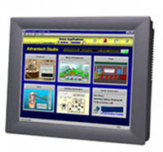
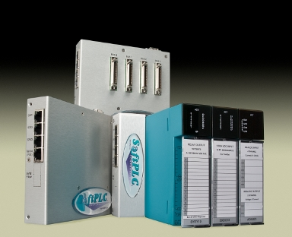
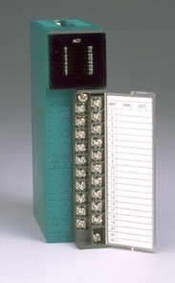
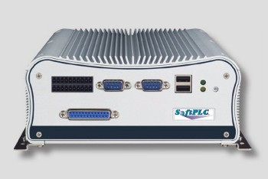
Product line overview

Slide 3
SoftPLC®
SoftPLC Programmable Automation Controllers (PAC’s)
Functionality of PLC’s, RTU’s and DCS controllers combined with data/computation functions of computers
All models include same features/functions and use same programming/maintenance software
Models differ in hardware only (e.g.: ports, memory, speed)
SoftPLC Gateways (Protocol Converters)
Any SoftPLC can be a Gateway
Higher performance/more features than other gateway products

Slide 4
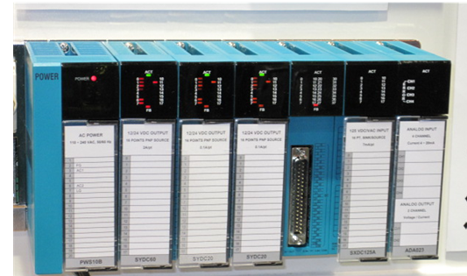
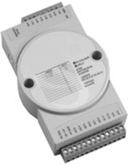
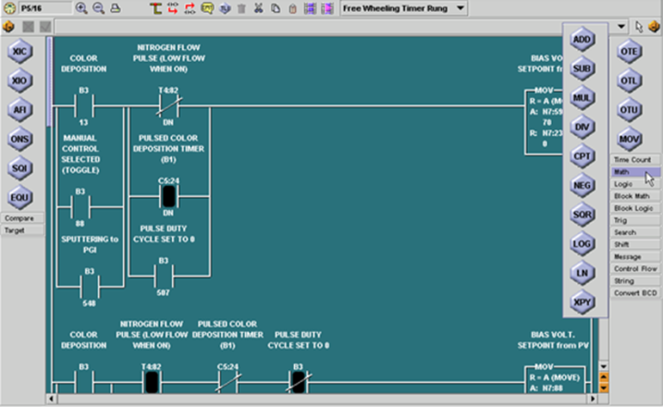
SoftPLC
Industrial I/O
Tealware™ - Modular rack-mounted I/O system, local & Ethernet configurations
A-Series – Low count/low cost serial & Ethernet I/O
Interface cards for industrial networks (e.g.: Profibus, DeviceNet)
TOPDOC® – SoftPLC Programming Software
Configuration, application development, troubleshooting
Available for Windows & Linux

Slide 5
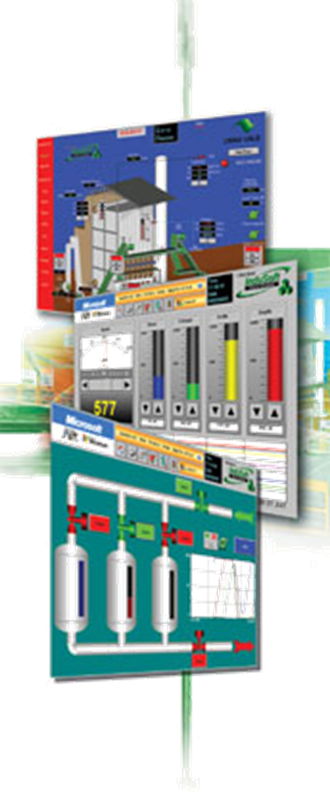
SoftPLC Web Studio
Web Studio is a complete SCADA software product
All features included, no add-on costs
Runs on any Windows environment, including mobile devices up to redundant servers
Web Studio HMI’s are Panel-PC’s w/ Web Studio runtime pre-loaded
3.5” - 17” sizes available in standard models
Custom sizes/specification models also available (e.g.: hazardous/marine area, other mounting options, etc.)

Slide 6
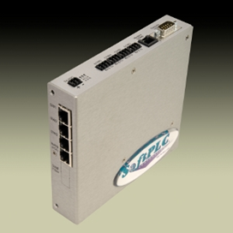
Communication Products
Gatecraft Industrial Ethernet Products
Switches/Routers
Media converters
Remote Access Modems
Wireless Interfaces
Firewalls/VPN’s
Remote Serial Servers
Smart Netbox
Gatecraft Shield

Slide 7
Company overview
1983
1985
1988
1993
1996
2001
2007
2009
Tele-Denken formed
1st Release SoftWires
1st Release SoftPLC
Name change to SoftPLC
Tealware I/O released
Linux Version SoftPLC
SoftPLC version Web Studio
SmartBoard released

Slide 8
History – Key Events
Founded in 1983 as Tele-Denken Resources, Inc.
By ex-Allen-Bradley employees
Privately held, Texas Corporation
US classified as small, woman-owned business
1980’s
Driver interfaces between PC’s & PLC’s (O•N•E)
A-B PLC programming software (TOPDOC®)
for PLC/PLC-2, PLC-3, PLC-5
A-B PLC emulation software (SoftWIRES™)
A-B private-labeled TOPDOC PLC-3 as 6200 software

Slide 9
History – Key Events
1990’s
SoftPLC Controllers
Tealware I/O
Changed company name to SoftPLC Corporation
2000’s
Gatecraft Linux O/S and Ethernet products
SmartBoard & Smart product family
SoftPLC Web Studio

Slide 10
Corporate Strengths
Inventors & Innovators
Many industry first software features/functions
Embrace & provide open architecture technologies
Apply computer technologies to industrial automation market
Focused market offering – specialize in industrial automation products
Experts in embedded software (e.g.: I/O drivers, networking, operating systems)
Reliability & Determinism comes first
Treasure customer feedback
React quickly to customer requests

Slide 11
Corporate Strengths
Excel in customer support services
No “case numbers”
Support staff are field experienced application engineers
“I can’t remember a time in the last 20 years that a vendor went to the lengths that SoftPLC Corp. did to ensure our projects were a success.” (USACE)
Worldwide network of technical distributors & system integrators for local support
24-7/365 support available

Slide 12
Customers
SoftPLC Customers can be found in a wide variety of industries world-wide
Wood/Paper – Boise Cascade, Weyerhaeuser, Int’l Paper, Bowater...
Food/Beverage –Safeway, Kraft, Pacific Shrimp, TeePak, Coca-Cola…
Transportation – Ford, Detroit Diesel, GM, Schenck, Lockheed, Toyota…
Quarries/Materials – Tilcon, LaFarge, Smurfit, Cadman…
Power – USBR, Detroit Edison, Dracena, NW Natural Gas, SCADA Solns…
Water – Ebasco, Taiwan Water, Miami-Dade County, City of Diamond IL…
Pharma/Semi-Con – Quest Labs, Bayer, 3M, Panasonic, ThermoBiostar…
PetroChem – BP, GE Plastics, China Petroleum, Shell, Dresser, Formosa…
Metals –ArcelorMittal, Alcoa, Valesul Aluminum, Midwest Metals…
and many more!

Slide 13
Project Story
1996-ongoing: US Army Corps of Engineers
Selected SoftPLC to replace old DCS system for hydroelectric controls after intense evaluation of controllers & I/O products
Currently >300 PLC's for unit controls, fish mgmt, navigation locks…
Each program ~10K rungs of logic, some have over 100K rungs
Due to project success, SoftPLC was selected in 2009 for Grand Coulee Dam upgrade by US Bureau of Reclamation
Largest power plant in the USA, 3rd largest in world (7GW)
Also pumps water to irrigate eastern half of Washington state
Using SoftPLC Web Studio HMI’s on this project too
Combined, SoftPLC is used to generate over 5% of US power and 17% of US Hydropower

Slide 14
Project Story
Nestle-Purina Pet Food 1997
1st application replaced PLC-5 that wouldn’t communicate to serial weigh scale
Replaced other PLC-5’s (all using existing 1771 I/O)
Plant standard became SoftPLC for all new applications
Despite Nestle standard of A-B

Slide 15
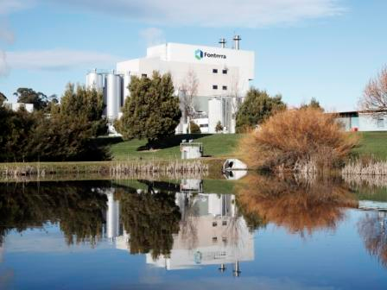
Project Story
1995 Fonterra/Bonlac Foods/United Milk Tasmania
PLC-5/80E out of memory & having comm problems
Replaced CPU, connected to existing 1771 & SLC-500 I/O
No changes to Citect SCADA required, comm problems fixed
Added 3 Profibus networks

Slide 16
SoftPLC PAC’s
Features/Functions

Slide 17
“What is a SoftPLC?”
SoftPLC is control software that turns an industrial computer into an open architecture controller
First “PAC” (Programmable Automation Controller) on the market
Embedded software, runs on dedicated “headless” systems (eg: no monitor, keyboard…)
Provides features of proprietary PLC’s (I/O control, PID) PLUS features of computers (flexibility, networking, speed)
Programming/Addressing modelled after A-B PLC’s
A-B PLC “on steroids”
Provides A-B users an easy, affordable upgrade path

Slide 18
Market Positioning
SoftPLC’s are not PLC’s
Better communications and data handling
Advanced features – even beyond proprietary PAC’s
Truly open architecture
SoftPLC’s are not PC-based controllers
Deterministic scan (“hard” realtime)
Online run-mode program changes
Troubleshooting tools like PLC (Runtime Fault detection/ correction, I/O Forcing)
Runs on embedded Linux, no Windows

Slide 19
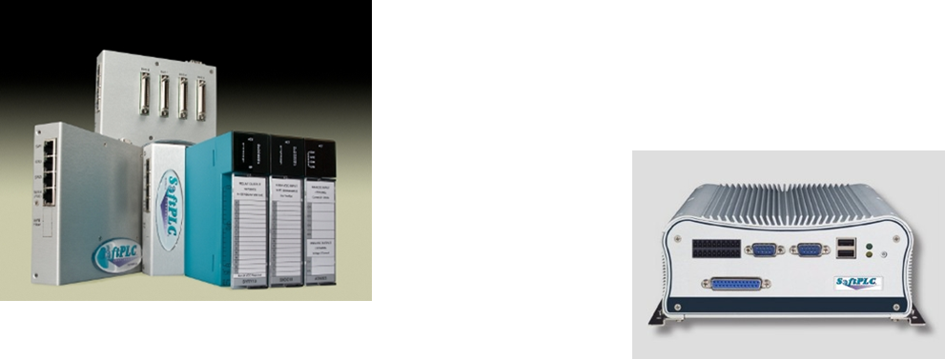
Hardware Models
Smart & Hardbooks for PAC/Gateway/Gatecraft

Slide 20
SoftPLC’s SmartBoard®
All SoftPLC “Smart” products are based on the SmartBoard® design
SmartBoard provides rugged, compact, low-cost and powerful platform
Customers can have common hardware for multiple product solutions
Programmable Controls, Protocol Gateways, remote access modem, industrial firewall
SmartBoard includes “hooks” for easy customization for OEM applications

Slide 21
SmartBoard Hardware
Metal enclosure, DIN-rail mount
Compact size (5.75”H x 6”D x 1.5”W)
Built-in managed Ethernet switch
(2) IP interfaces for routing capability
(4) RJ-45 10/100MB ports
Fiber optic options on 1 port
(6) serial ports
(1) 9 pin RS-232 interface
(3) RS-232 ports
(1) RS-485, 2-wire
(1) factory configurable port (e.g.: Modem, RS-485 2/4 wire, A-B RIO)

Slide 22
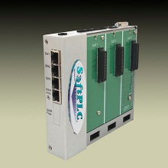
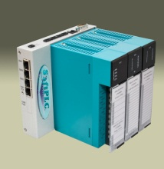
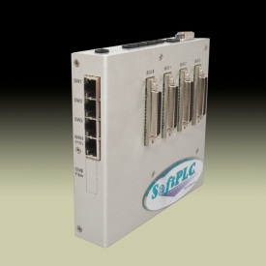
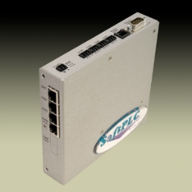
Smart SoftPLC I/O Interfaces
Selectable I/O interfaces
Local Tealware Interfaces
Backplane3 supports any 3 modules directly mounted on CPU
LocalPorts supports up to 12 Tealware racks, up to 30’ from CPU
Remote I/O
Ethernet (e.g.: ModbusTCP)
Serial (e.g.: Modbus)
A-B RIO
Bus I/O via PCI-104 interfaces (e.g.: Profibus, DeviceNet)
Supports up to 3 interface cards

Slide 23
Smart Environmental Specs
Low power requirement (2-5W based on options)
14-48VDC or Power-Over-Ethernet
Industrially Rated:
0~60ºC operation, -20~85ºC storage
Extended temperature option available -20~70ºC
Humidity: 0~95% non-condensing
Fanless/Diskless system
Watchdog Timer
RoHS compliant

Slide 24
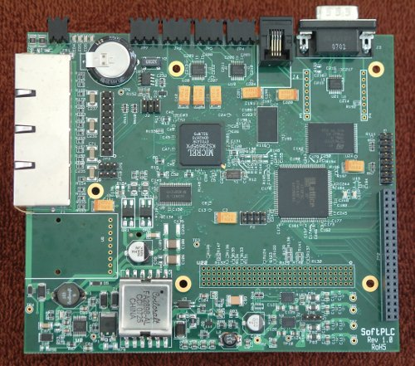
SmartBoard Internals
COM 5
RS-485
(or A-B RIO)
}
14~48VDC Power
COM 2-4
RS-232
COM 1
(RS-232) “Console”
COM 6
Phone Modem,
RS/485, or other
serial to RJ-11 (eg: A-B RIO)
3.3V
}
Enet 1
LAN
SuperCap
~60 days battery-free RTC power
63MB
SDRAM
10/100MB ManagedEthernet Switch
Enet 2
LAN
20 pin
JTAG
4MB
Boot Flash
Enet 3
LAN
166MHz ARM9 CPU
}
(5) GPIO
(3) FPGA I/O
WAN (PoE)
FPGA
}
SPI & 3.3V
(2) LED's tied to FPGA
PCI-104
Bus Interface
(32) lines
FPGA I/O (3.3V)
+3.3 & 5V power
Fiber Connector
(optional)
25W sourcing P/S (12W in PoE mode)

Slide 25
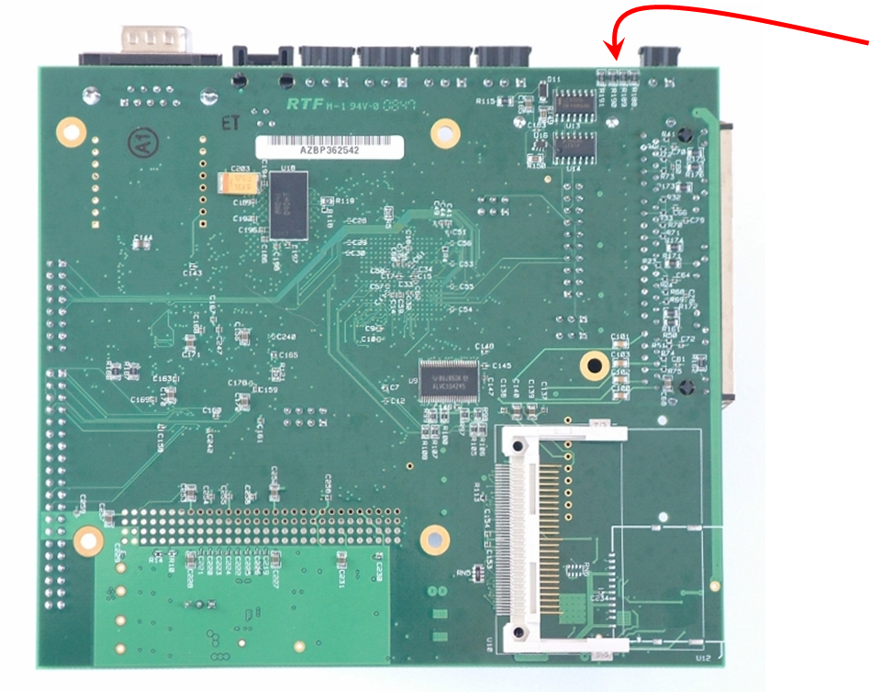
SmartBoard Internals
149.09mm
(4) LED's for system control indication
133.35mm
}
Compact Flash Interface (8 GBytes)
(future) SD Flash

Slide 26
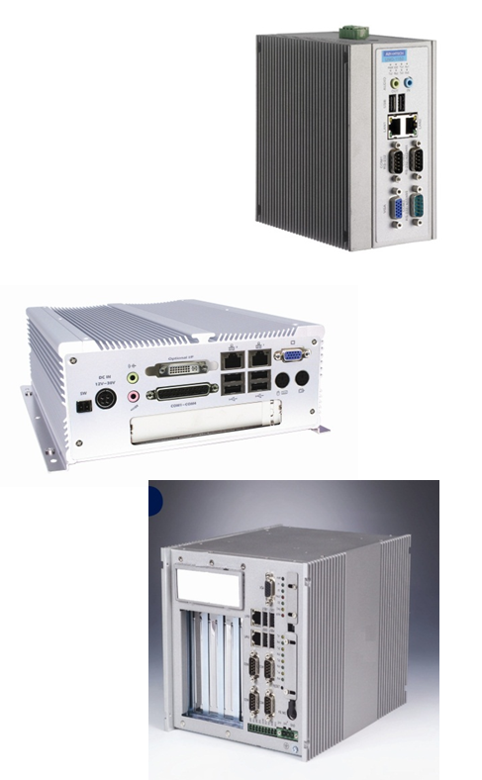
Hardbook Products
Powerful, stand-alone CPU’s
Fanless, diskless
Multiple Ethernet, serial, USB ports
Up to 2GB RAM
Some models have PCI slot(s) for add-in cards
Many standard models
Custom versions available based on application requirements (ie: slots, form factor, communication ports, environmental)

Slide 27
SoftPLC PAC’s
Firmware Features/Functions

Slide 28
User Memory
Data Table Registers
10K files of 10K elements each (100M words)
Addressing similar to A-B PLC-5/SLC-500
Binary, integer, floating point, PID, strings
Timer, counter, arrays, more
Status file for fault analysis, RTC, etc.
Every bit accessible by address or tag
Non-sequential display feature (Watch Window)

Slide 29
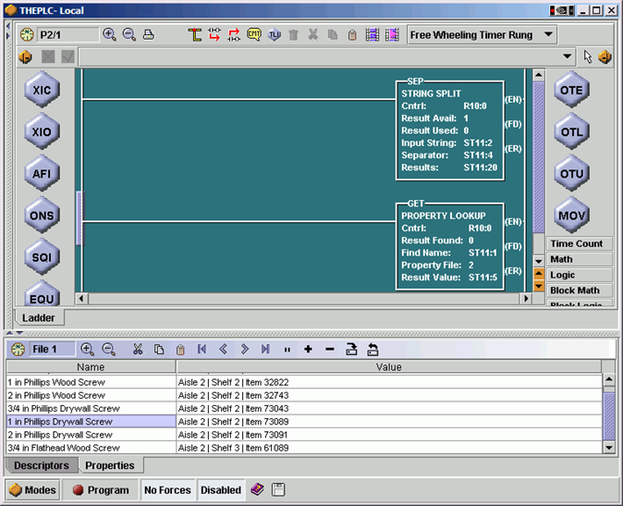
User Memory
“Property Tables”
Internal relational database
Up to 10K tables of 10K elements each
Ideal for use in sorting, recipe, warehouse applications
Ladder instructions provided to read and process data records

Slide 30
User Logic
Powerful Ladder Logic instruction set
Over 135 standard functions
Relay logic, timer/counter, math, data, PID, strings, more
Similar to PLC-5/SLC-500 programming
Program by address or tag
Up to 10K subroutines of 10K rungs each
All logic documentation stored in SoftPLC

Slide 31
User Logic
TOPDOC Loadable Modules (TLM’s) extend instruction set
Created in C⁺⁺ using toolkit, by SoftPLC Corp or customers
Can be ladder instructions, drivers, or program tasks
Examples
Calculations (Fourier transforms, cavitation, AGA gas flow)
Device Interfaces (motion controller, I/O devices, PC cards)
Encapsulate proprietary logic in a function block
Read/write to database
Print reports/Write files to remote disk

Slide 32
User Logic
Some SoftPLC provided TLM’s:
COMGENIUS – ASCII / Serial Communications
Drives, bar code/RFID, weigh scales, process equipment
Simple Modbus Master communications
Log Data – Event Logging to CSV or binary formats
Send Email/Text Message
Includes support for attachments (e.g.: log files)
Supports multiple recipients

Slide 33
I/O Support
Supports up to 8K digital & unlimited analog
Up to 16 I/O drivers can be used simultaneously
Some available drivers
Tealware local & remote I/O
ModbusTCP Ethernet
A-B RIO
Industrial bus (e.g.: Profibus, DeviceNet, CANOpen, etc.)
Serial I/O (Modbus & proprietary)
PC bus I/O (e.g.: PCI, PCI/104 or direct CPU mounted I/O)
Third party driver development supported via toolkit

Slide 34
Communications
Connection to SCADA/HMI, programming, peer-to-peer communications
Multiple networks supported simultaneously
Ethernet (A-B Enet, ModbusTCP)
Serial (DF1, Modbus)
Industrial Bus (e.g.; A-B DH+, Profibus)
SoftPLC appears as A-B PLC-5 or Modbus device on the network
All HMI/SCADA/DCS products supported
OPC Servers supported

Slide 35
Communications
Built-in FTP & SSH Servers
Used to access SoftPLC flash disk files over Ethernet/serial ports
Update/backup configurations, firmware, other files
Low-level troubleshooting & diagnostics
Access system logs
Run command line programs
Use any FTP/SSH client program

Slide 36
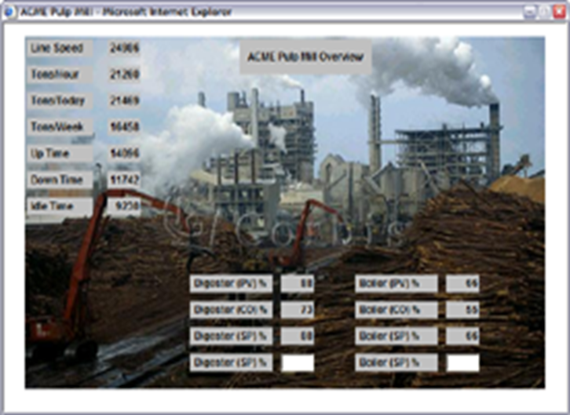
Embedded Web Server
Optional firmware add-on module
Supports live pages in SoftPLC
Pages update in real-time with application data
Develop pages using any HTML editor
Animation/data update can be done with C⁺⁺, PHP, Python & other web technologies
View with any web browser

Slide 37
Embedded Firewall
Optional firmware add-on module
Provides high-end protection and secure remote access
Stateful inspection, NAT/IP masquerading, blacklisting
Multiple VPN tunnels
Ethernet & PPP protection

Slide 38
Hot Standby/Redundancy
Optional firmware add-on module
Comprehensive solution for applications needing 100% uptime
Bumpless transfer of I/O control in case of primary CPU fault
High speed data transfer between primary/secondary controllers on dedicated Ethernet connection
Uses “dumb” arbitrator to assist with switch-over
Status available over network to SCADA/HMI, I/O, TOPDOC, other controllers
With Tealware I/O, fully redundant systems (CPU, I/O, P/S) possible

Slide 39
Old PLC Upgrades
PLC-5, PLC-2/PLC, SLC-500, MicroLogix conversion services from SoftPLC
Automated utility programs convert on average 95% of program logic and documentation
SoftLogix5, PLC-5/250 & PLC-3 conversion services quoted per application
Semi-automated conversion process averages 85%
Other PLC conversions quoted per application
Control/CompactLogix
Schneider, Siemens, GE Fanuc

Slide 40
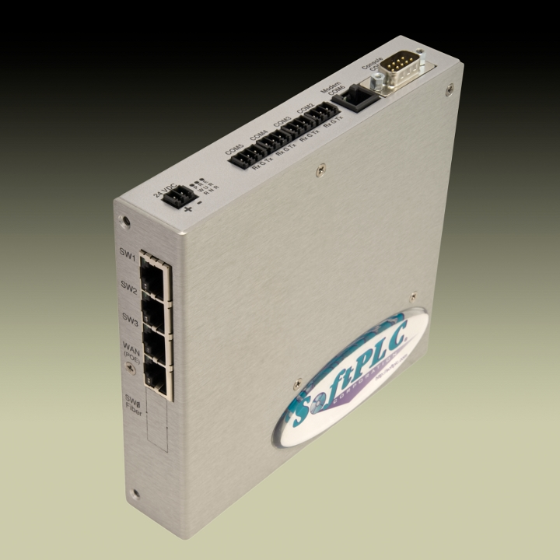
SoftPLC Gateways
Smart Gateway
Hardbook Gateway
Configurable Protocol Converters & More….

Slide 41
Flexibility
Up to 16 protocols per Gateway
Supports multiple serial and Ethernet protocols
All supported protocols always included – no need to order/stock different part numbers
Select mix of master & slave protocols
Industrial bus networks implemented via hardware add-on(s), base unit remains unchanged
Via Toolkit, users can add custom protocols

Slide 42
Ports, Ports, Ports!
Minimum (2) Ethernet interfaces (MAC ID’s)
Routing functions included
Wireless and fiber options
Minimum (4) serial ports
Up to 8 industrial network interfaces (eg: Profibus, DeviceNet, etc.)

Slide 43
Data / Throughput
No data limits
100 Million 16-bit words per Gateway
Fastest Gateways on the market
Highly optimized drivers
Developed as PLC I/O drivers and/or PLC peer-to-peer communication

Slide 44
Intelligence
Supports user logic for data manipulation
Scaling, totaling, etc. via ladder logic
Data logging to local flash and/or to network drives
Email/texting functions can send alarms, data or data files as attachments
Great solution for data concentrator applications

Slide 45
Security
Linux, FTP/SSH security by passwords
TOPDOC security
Firewall/VPN (firmware option)
Protection of Gateway and connected devices from unauthorized access on any Ethernet or modem connection
Remote access to Gateway data and configuration

Slide 46
Diagnostics
All protocols provide detailed error reporting
User logic can automatically detect errors
Report errors to attached SCADA/HMI
Report errors via email/text messages
Send peer-to-peer message to connected devices (if supported by device/protocol)
Via connected I/O (optional) can issue alarms, modify machine/process behavior, etc.

Slide 47
Control
Connected I/O and devices can be controlled by Gateway via ladder logic
SoftPLC Tealware local I/O
Serial (eg: Modbus)
Ethernet (eg: ModbusTCP)
Industrial bus (eg: Profibus, DeviceNet)

Slide 48
Data Access
Any HMI/SCADA/DCS system can access Gateway data
Ethernet or serial connection via standard PLC drivers
Toolkit enables user to write programs to read/write data over Ethernet
Gateway can interface directly to databases (eg: SQL)

Slide 49
Easy configuration
Easy to configure
Configuration via Ethernet
No programming required
XML or text configuration files to map data from PLC/network address to internal Gateway address
Free industrial bus network configuration / diagnostic software included with hardware interface(s)
TOPDOC is used as configuration and diagnostic tool

Slide 50
Communication products
Smart Netbox, Other Gatecraft products

Slide 51
Smart Netbox
Comprehensive “communications appliance”
Industrial managed 4 port Ethernet switch/router
Supports PoE (Power over Ethernet)
Media converter (10/100BaseT to Fiber)
Remote Access Modem (w/ optional SM-MDM)
Access any Ethernet device remotely via phone
Lower cost & more powerful than competitor products
Industrial Firewall/VPN (w/ optional GC-FW firmware)
Remote Serial Server (w/ optional GC-SDS)

Slide 52
Other Gatecraft Products
Product family name for all communication products
Firewalls/routers
Gatecraft Shield - Ethernet to Ethernet protection
Gatecraft Junction - Ethernet to Modem protection
Gatecraft Beacon - secure WAP
Gatecraft Link - Ethernet switches & media converters
Unmanaged, low-cost, DIN-rail options
10/100, 10/100/1000, and fiber
High-end switches (RuggedCom products)

Slide 53
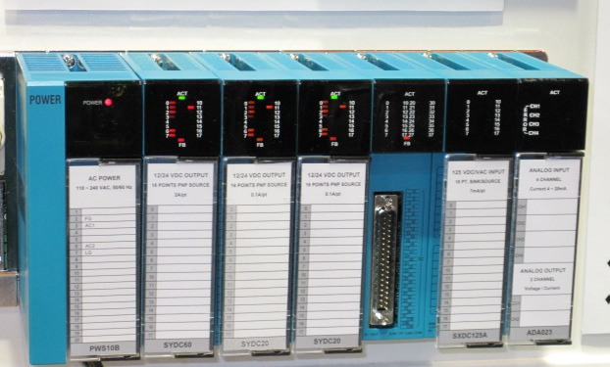
I/O
Tealware, A-Series, Other options

Slide 54
Tealware I/O
Modular, high-density I/O system
Local and remote Ethernet configurations supported
Wide variety of digital, analog, & specialty modules
Easy to troubleshoot/maintain
Detachable terminal block for easy replacement w/o re-wiring
Diagnostic & Status LED’s
Wide angle swing connector for easy installation
Digital modules hot-swappable under power

Slide 55
Tealware I/O
Local interface to Smart SoftPLC or Smart Adapter
3 modules per Backplane3 interface
Connect to expansion racks via LocalPorts interface
Up to 12 bases per Smart SoftPLC
Up to 3 bases per Smart Adapter
Remote interface to any SoftPLC CPU via Ethernet
Up to 255 drops per SoftPLC CPU
Modules fit into Rack Base
6 or 8 module slot bases available
Up to 10 feet between bases

Slide 56
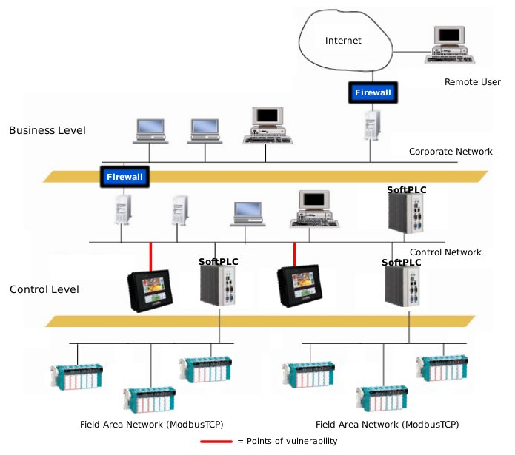
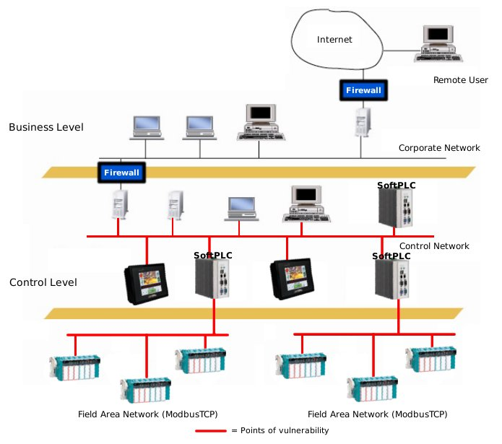
Smart Adapter
Decision making can be done at adapter level
Define failure state based on process conditions
Can take over as local controller if communication to master fails
High level features (eg: remote decision making, SOE)
Embedded Firewall for security (w/ Cat No SM-FW option)
Network security increases with
Smart I/O Adapter/Switches

Slide 57
A-Series I/O
Cost effective for applications requiring low count / small space / widely distributed I/O
Serial RS-485 modules – over 90 signal types available
Ethernet ModbusTCP modules – no adapter required, each module its own IP address
DIN-rail mount and modules can be stacked
Sourced from multiple vendors as needed

Slide 58
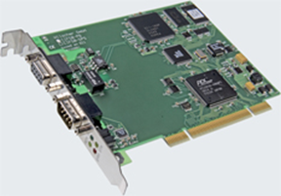
Other I/O Options
Using loadable drivers and appropriate hardware interfaces, SoftPLC CPU’s can communicate to other vendor I/O equipment
Any ModbusTCP, Modbus
Industrial buses (e.g.: Profibus, DeviceNet)
PC bus cards, motion control interfaces
Via toolkit, additional drivers can be developed

Slide 59
Configurations

Slide 60
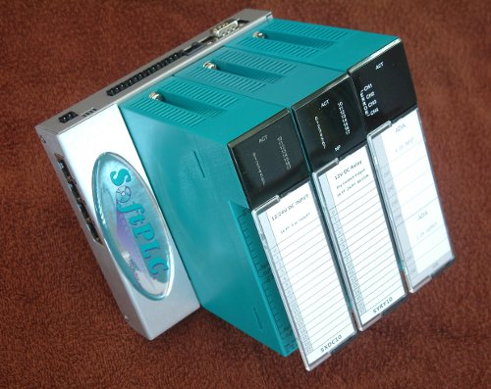
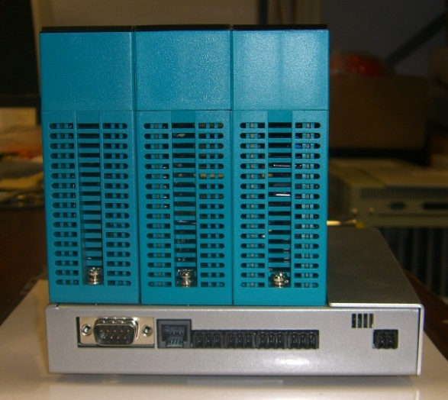
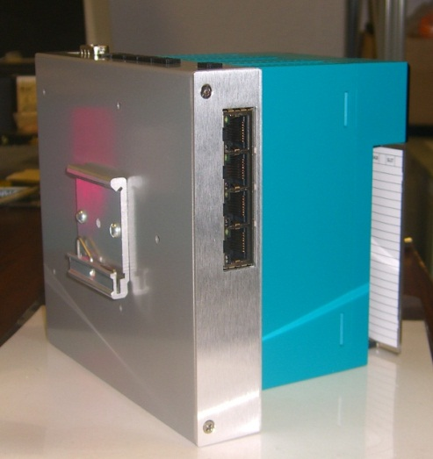
Backplane3 Configuration
BASE0x (Backplane)‏

Slide 61
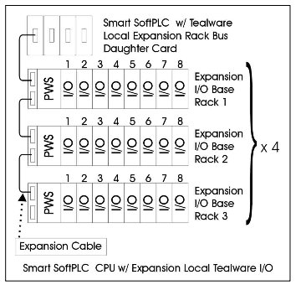
LocalPorts Configuration

Slide 62
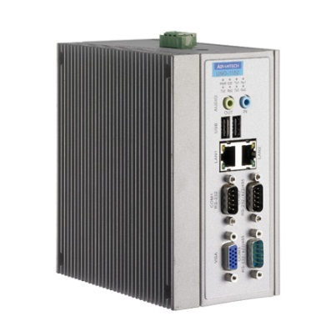
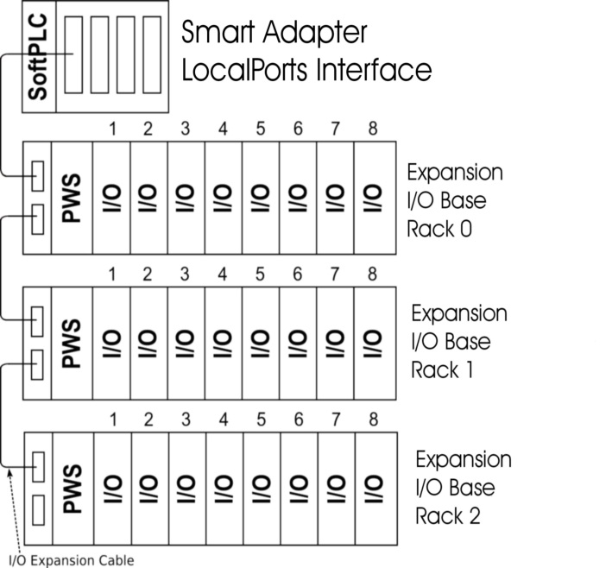
Example Configurations
Hardbook SoftPLC
(Cat No HB-M0LE-x)
Smart SoftPLC
(Cat No SMS11-B)
Ethernet
ModbusTCP
I/O Modules
Ethernet
ModbusTCP
Smart Adapters
(Cat No SMS11-B)

Slide 63
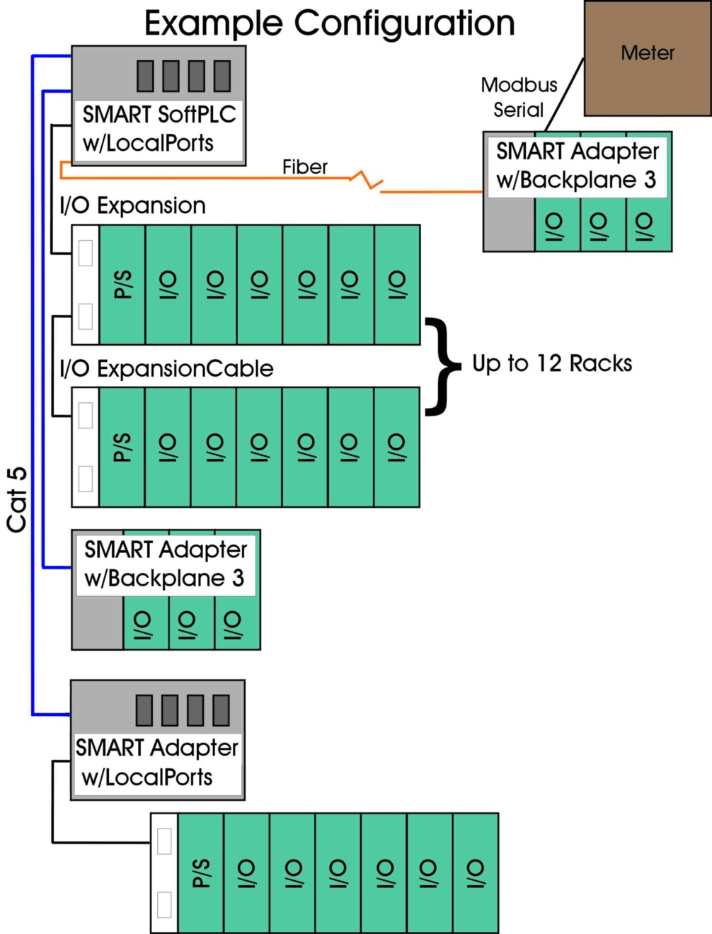
Flexible!

Slide 64
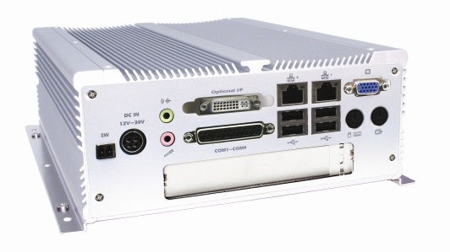
Bus I/O Configurations
Smart SoftPLC or Hardbook with Bus I/O
Profibus
ASI
DeviceNet
Interbus
CANOpen
SERCOS
etc.
+
Hardbook SoftPLC/Gateway
Bus Interface Card
(up to 8 cards)
+
Smart SoftPLC/Gateway
w/ PCI-104 bus option
PCI-104 Bus Interface Card
(Up to 3 cards)

Slide 65
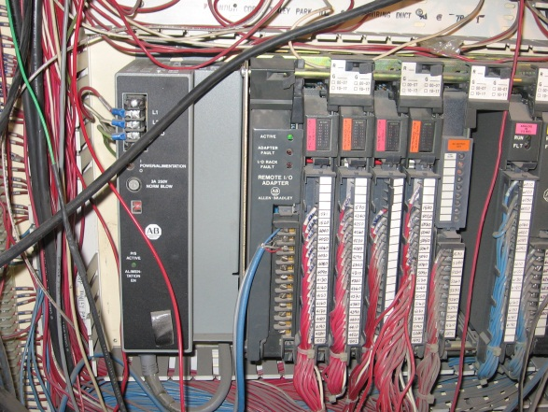
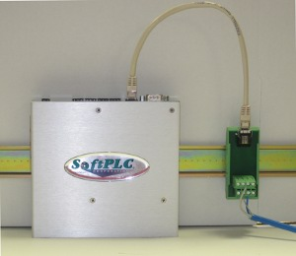
A-B RIO Configurations
Hardbook/Processor with A-B Remote I/O
+
Hardbook SoftPLC
(Cat No HB1-HPLA-x)
1785-PKTX/PKTXD*
(Cat No SPO-PKTX)
Smart SoftPLC w/ A-B RIO interface
1771-ASB
or other A-B RIO Adapter

Slide 66
Allen-Bradley Upgrades with SoftPLC Controllers
THE Best Solutions
to upgrade A-B PLC's & HMI's
Minimizing cost, downtime, training & re-engineering

Slide 67
A-B PLC Upgrades
Motivation:
Product/programming software obsolescence
Older technology lacks desired features/ communications
Why upgrade vs replace?
Cost/downtime to replace entire system prohibitive
I/O typically not an issue, only the CPU
“80% of end users surveyed were upgrading their control systems only, leaving field devices 'as is'.” Larry O'Brien, ARC Advisory Group

Slide 68
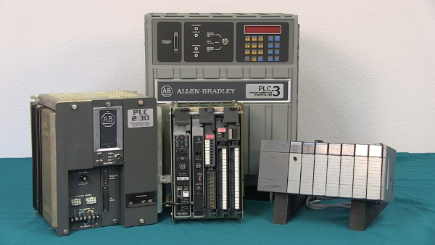
A-B PLC Upgrades
Models Supported
PLC-5/SoftLogic5
SLC-500/MicroLogix
PLC-2, 1774 PLC
PLC-3, PLC-5/250
Multiple I/O Types Supported
RIO (eg: 1771, 1747, Flex, Block, etc.)
DeviceNet, Profibus, etc. also supported via interfaces in SoftPLC CPU

Slide 69
A-B PLC Upgrades
Process -
Convert logic/documentation
Replace A-B PLC CPU with SoftPLC Controller
Existing I/O can remain virtually untouched
Many options for future upgrades/expansion
Existing HMI/SCADA can remain, if desired
Existing communication networks can remain or be upgraded to Ethernet

Slide 70
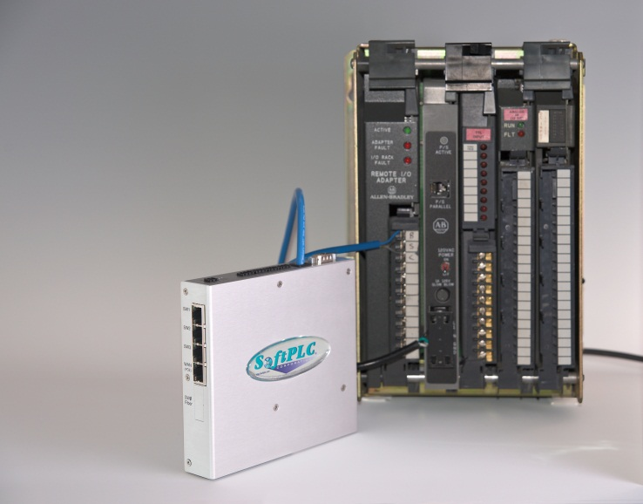
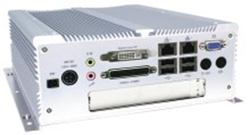
A-B PLC Upgrades
SoftPLC Hardware Options

Slide 71
SoftPLC Hardware Options
Smart SoftPLC with A-B RIO interface
Supports 2 RIO channels (32 adapters/channel)
CPU includes Ethernet switch, multiple serial ports for DF1 or other protocols
DH+ available via external serial interface
RIO “blue hose” connection points

Slide 72
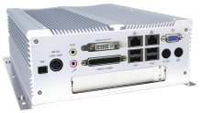
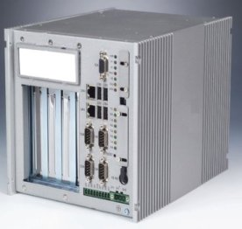
SoftPLC Hardware Options
Hardbook SoftPLC w/ A-B Interface(s)
Interface is via a PCI slot card
1 or 2 port cards available
Ports can be A-B RIO or Data Highway Plus protocol
Up to 8 cards are supported by SoftPLC

Slide 73
A-B PLC Upgrade Process
by PLC Model

Slide 74
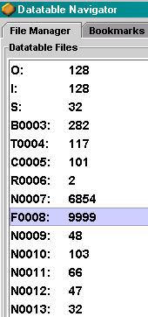
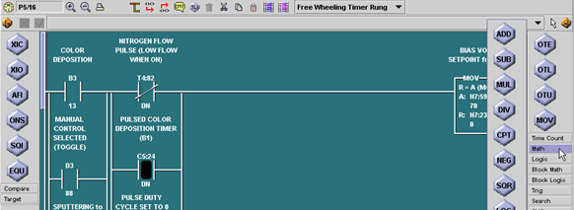
A-B PLC-5 Upgrades
SoftPLC logic/data table is a superset of the PLC-5
Automated program conversion utility normally 98% or better (more of an import than a conversion)
Resulting logic looks nearly identical to users
HMI/SCADA does not normally need any changes (unless network type changes)

Slide 75
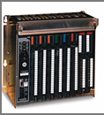
A-B PLC-5 Upgrades
Hardware Changes
Re-configure PLC-5 CPU as Remote I/O Adapter
Add SoftPLC Controller w/ A-B RIO interface

Slide 76
A-B SoftLogic5, PLC-5/250
Similar to PLC-5, but often text output needs to be “tweaked” before import
Add-on functions often need manual intervention, but can usually be supported with a SoftPLC TLM (loadable add-on) function

Slide 77
A-B PLC-2 Upgrades
Automated conversion from PLC-2 logic to SoftPLC logic
Program conversion normally 95% or better
Converts from TOPDOC PLC-2 format
Conversion cost includes loan of TOPDOC PLC-2 to upload program
Documentation conversions available from most PLC-2 software programs
HMI/SCADA: SoftPLC has a PLC-2 compatibility mode to minimize changes required

Slide 78
A-B PLC-2 Upgrades - Hardware
PLC-2/30, -2/20, -2
Replace PLC-2 CPU with SoftPLC Controller w/ A-B RIO interface
If remote I/O, no changes required
If local I/O, replace adapters with remote adapters (1771-ASB)
Mini PLC-2's
Replace PLC-2 CPU with remote I/O adapter
Add SoftPLC Controller w/ A-B RIO interface

Slide 79
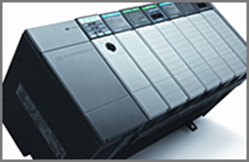
A-B SLC-500 Upgrades
Automated conversion utility normally 95% or better
Converts logic & documentation
Provides text file identifying what conversion process did & any areas of concern
Also provides equivalent Tealware I/O modules
HMI/SCADA does not normally need any changes (unless network type changes)
Resulting logic looks nearly identical to users (except for I and O addresses)

Slide 80
A-B SLC-500 Upgrades
Hardware Changes (if keeping A-B I/O desired)
Replace SLC-500 CPU with 1747-ASB remote I/O adapter
Add SoftPLC Controller w/ A-B RIO interface
Or, replace entire system (if retaining IP the main desire)

Slide 81
A-B PLC-3 Upgrades
Semi-Automated Conversion Utility
Standard logic/documentation converts 90% or better
Pointers, GA Basic, etc. must be manually converted (by user or SoftPLC can quote on per program basis)
HMI/SCADA does not normally need any changes (if PLC-2 compatibility mode was originally used)
Hardware: Replace PLC-3 CPU w/ SoftPLC Controller w/ A-B RIO Interface

Slide 82
A-B PLC Upgrades
Why SoftPLC
instead of A-B
Upgrade Solutions?

Slide 83
Why SoftPLC vs A-B
A-B document on PLC-5 logic conversion is 80 pages
53 pages (67%) discuss conversion “issues”, items that need to be manually reviewed, etc.
27 pages (34%) are index, TOC, and instructions on export/import of logic and running the conversion utility program
SoftPLC list of issues is 1 page

Slide 84
Why SoftPLC vs A-B
Resulting system more similar to old system
Little training needed for maintenance personnel or operators
Less risk of problems after conversion
Advanced features at no cost
Ethernet/routing is standard feature
Minimum user memory per SoftPLC is 64MB
PAC functions standard (logging, email, internal database, Modbus/other drivers, more )
More...

Slide 85
Why SoftPLC vs A-B
Hardware Cost Savings
Smart SoftPLC w/ A-B RIO interface $1500-$2500
ControlLogix CPU, rack, P/S plus 1756-RIO minimum $7000
Common Solution for all applications
Same SoftPLC products can range from smallest to largest applications (reduces inventory, training, software, etc cost)
A-B has different products with unique physical structure such as I/O (MicroLogix, CompactLogix, ControlLogix)

Slide 86
Why SoftPLC vs A-B
More options for future
SoftPLC is open architecture, multiple choices of vendor for I/O, networks, drives, etc.
Rockwell Automation solutions drive customer to all Rockwell products
Reduce automation costs long term

Slide 87
SoftPLC Web Studio

Slide 88
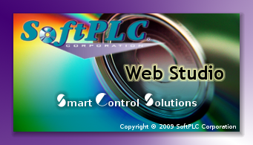
Web Studio Applications
HMI
SCADA
Equipment Status
Real-Time Control
Data Acquisition/Reports
Recipes/Trends
Alarms
Control Room
Product Scheduling
Yields and Throughput
Quality Control
Statistics
Manufacturing
SCADA HMI
Enterprise
Web Studio spans applications from plant floor to control room to Enterprise.

Slide 89
Web Studio Overview
Real-time graphical interface to develop industrial automation, instrumentation, and embedded systems
Over 150K installations world-wide in a wide range of applications and industries
Runs on any Microsoft Windows operating system
Including mobile and embedded O/S
Conforms to industry standards such as OPC, ODBC, XML, ActiveX

Slide 90
Web Studio Functions
Object oriented graphic displays
Data logging & reporting, real-time & historical trending, alarms & recipe management
Tag database with a wide variety of data types
Programming via flexible scripting language
Automatic language translation
Multi-level application security
Web-Enabled to run applications in a browser

Slide 91
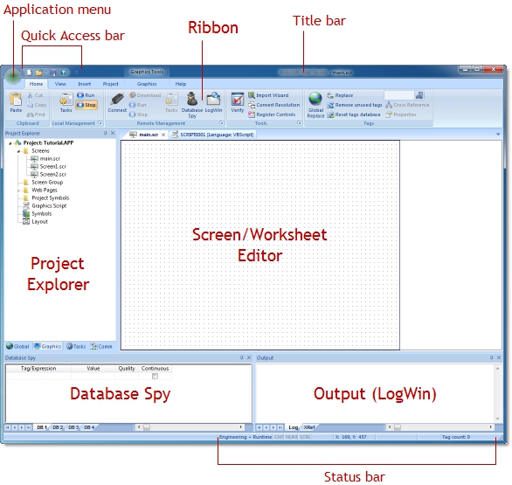
Development Environment
Integrates seamlessly with other applications
Windows desktop applications (e.g.: Word/Excel)
3rd party packages (e.g.: C/C⁺⁺, VB)
Online configuration, debugging
Extensive support tools
Message register, error/event codes
Database Spy
LogWin
Context sensitive help

Slide 92
Web Studio Features
Create stand-alone & web applications from the same development environment
Object oriented environment (screen/object re-usability)
Powerful/flexible tag database with Boolean, real, string & array tags, classes & indirect pointers
Advanced math library with >100 standard functions
Programming via flexible/easy-to-use scripting languages

Slide 93
Web Studio Graphics
Create sophisticated interfaces with point & click, drag & drop
Import graphics from >15 formats
Full-featured screen objects & dynamics with customizable properties
Bar graphs, color, resizing, blinking, animation, scale, fill, positioning, rotation, commands, hyperlinks, combo-boxes, text input/output, and more
Extensive symbol library

Slide 94
Web Studio Alarm System
Sophisticated alarms management system
Send alarms to screen/email/browser
Free format alarm messages
Archive alarms to file, printer, or database
Filter, sort, or color sort alarms
Filter by category

Slide 95
Data Acquisition
Trending
Keep track of process behavior online or via historical data
Distribute information throughout network for easy monitoring on screens or web browsers
Recipes & Reports
Create flexible, user-defined recipe groups
Import/export recipes, reports & real-time data in XML, text or user-definable database formats
Publish to web browsers

Slide 96
Input/Output
More than 200 communication drivers to PLC’s, I/O & other devices/networks
Supports OPC server & client
Conforms to industry standards (e.g.: .NET, OPC, ODBC, XML, SOAP, ActiveX)
SoftPLC Ethernet driver supports entire data table range

Slide 97
Web Studio Products
Development Software
Non-modular – all functions & drivers included
Create applications for all target runtime hardware & O/S
Offered by tag count
1500, 4K, 16K, 32K, 64K, unlimited
Combined Development/Runtime license available

Slide 98
Web Studio Products
Runtime software
Includes runtime & (1) each Web/Thin/SMA clients
Additional clients can be added (up to 128/system)
Available for WinCE, Win Embedded, or Windows
Offered by tag count & number of communication drivers
Web Studio Runtime Licenses
150 tags, 1 driver | 16K tags, 5 drivers
300 tags, 1 driver | 32K tags, 5 drivers
1500 tags, 3 drivers | 64K tags, 8 drivers
4K tags, 5 drivers | “unlimited” tags, 32 drivers

Slide 99
Web Studio HMI’s
Touchscreen Panel PC’s with Web Studio Runtime license factory installed
3.5” to 17” sizes available
Customized sizes/environmental/packaging also available on request
All systems fanless, ruggedized hardware
Ethernet, serial & USB ports

Slide 100
Thanks!
http://softplc.com
info@softplc.com

