Slide 1
M2M Solutions

Slide 2
Company overview
1983
1985
1988
1993
1996
2001
2007
2009
2013
2014
2015
1st Release TOPDOC/SoftWires
Tealware I/O released
Linux Version SoftPLC
SoftPLC version of Web Studio
SmartBoard released
TagWell released
Micro SoftPLC released
IoTView released
Tele-Denken formed
1st Release SoftPLC
Name change to SoftPLC

Slide 3
Company Overview
Founded in 1983
By ex-Rockwell Automation /Allen-Bradley employees
Privately held, Texas Corporation
US classified as small, woman-owned business
Industrial Automation Product & Software Manufacturer
Products sold world-wide
Multiple Sales Channels
Direct
Industrial distributors & sales reps
Automation system integrators
OEM’s

Slide 4
Corporate Strengths
Inventors & Innovators
Many industry first features/functions
Embrace & provide open architecture technologies
Apply computer technologies to industrial automation market
Experts in embedded software (e.g.: I/O drivers, networking, operating systems)
React quickly to customer requests for modifications/ enhancements
Product architecture & 30+ years code base reduces engineering effort & cost
Opportunity-driven product development schedule

Slide 5
Corporate Strengths
Excel in customer technical support services
No “case numbers”
Support staff are field experienced application engineers
“I can’t remember a time in the last 20 years that a vendor went to the lengths that SoftPLC Corp. did to ensure our projects were a success.” (Electrical Engineering Director, US Army Corps of Engineers)
24-7/365 support available
Worldwide network of technical distributors & system integrators
Local support
System configuration/programming/installation

Slide 6
SoftPLC Corp. Customers
Customers world-wide in a vast array of industries & applications:
Wood/Paper – Boise Cascade, Weyerhaeuser, Int’l Paper, Bowater...
Food/Beverage – ADM, Safeway, Kraft, TeePak, PepsiCo…
Oil/Gas – Exxon Pipeline, BP, SummitESP, CANRig, Imperial Oil & Gas…
Transportation – Ford, Detroit Diesel, GM, Schenck, Lockheed, Toyota…
Quarries/Materials –Tilcon, LaFarge, Smurfit, Cadman…
Power –Detroit Edison, Dracena, NW Natural Gas, SCADA Solns…
17% of USA Hydro and 5% of USA Power is SoftPLC generated
Water – Ebasco, Miami-Dade, Utilities Inc, Tonawanda…
Approx 60% of water applications in Taiwan are SoftPLC controlled
Pharma/Semi-Con – Quest Labs, Bayer, 3M, Panasonic, ThermoBiostar…
PetroChem – Sabic Plastics, China Petroleum, Shell, Formosa…
Metals – ArcelorMittal, Alcoa, Valesul Aluminum, Midwest Metals…
and many more!

Slide 7
Project Story
1996-ongoing: US Army Corps of Engineers selected SoftPLC to replace old DCS system for hydroelectric dams
> 350 PLC's for unit controls, fish mgmt, navigation locks…
Due to project success, SoftPLC was selected in 2009 for Grand Coulee Dam upgrade by US Bureau of Reclamation
Largest power plant in the USA, 3rd largest in world (7GW)
Pumps water to irrigate eastern half of Washington state
Also using SoftPLC Web Studio HMI’s
Combined, SoftPLC is used to generate over 5% of US power and 17% of US Hydropower
Number of dams automated growing every year

Slide 8
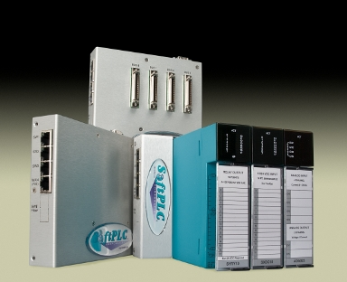
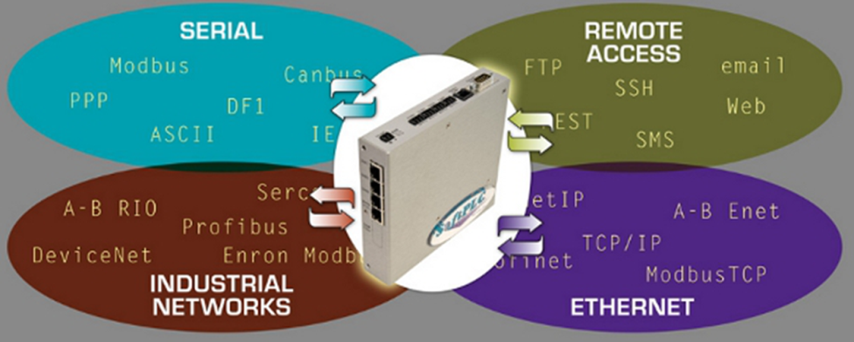
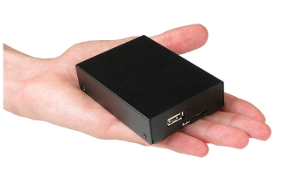
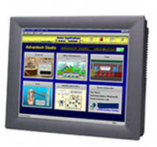
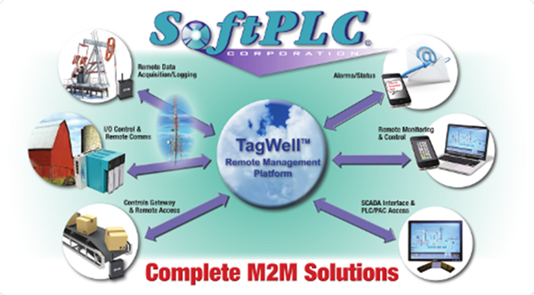
Product line

Slide 9
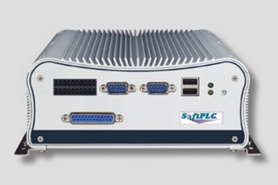
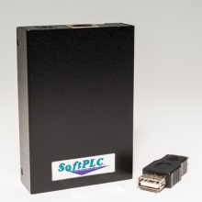
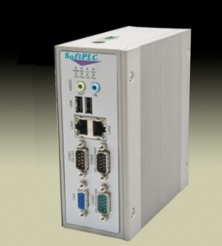
SoftPLC®
SoftPLC PAC’s (Programmable Automation Controllers)
PLC’s/RTU’s/DCS functions + data handling, computation and communication functions of computers
All models include same features/functions and use same programming/maintenance software
Models differ by hardware only (e.g.: ports, memory, speed, ratings/certifications)
Open Architecture – easy to interface to multiple vendor’s I/O, HMI/SCADA & other equipment

Slide 10
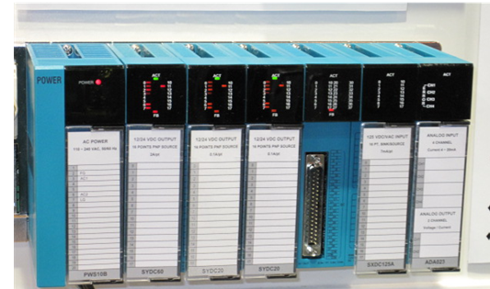
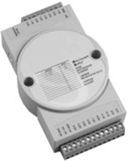
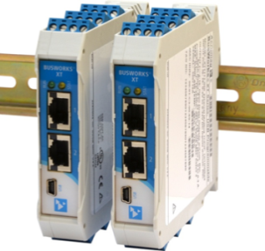
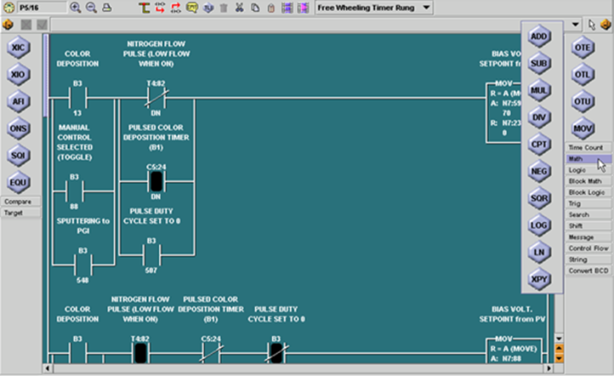
SoftPLC
Industrial I/O
Tealware™ - Modular rack-mounted I/O system, local & Ethernet configurations
A-Series – Low count/low cost serial & Ethernet I/O
BW-Series – Ethernet I/O, Hazardous area rated
Interfaces to industrial networks (CAN/J1939, Profibus, etc.)
TOPDOC® – SoftPLC Programming Software
Configuration, application development, troubleshooting
Available for Windows & Linux

Slide 11
SoftPLC Gateways
Any SoftPLC PAC can also be used as a Protocol Gateway
Up to 16 protocols per Gateway (serial, Ethernet, field-buses, proprietary)
Supports user logic for data manipulation (scaling, concentration, etc.)
No data limits
Highly optimized drivers
Supports any HMI/SCADA
Optional Firewall
Example Applications
A-B upgrades of HMI’s, drives
Oil & Gas (eg: Modbus serial to Ethernet, CAN/J1939 to ModbusTCP)
Toyota Stamping Press Gateway Application

Slide 12
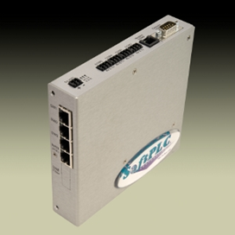
Communication Products
TagWell™
Remote Management Platform
Industrial Ethernet Products
Switches / Routers
Media converters
Modems / Wireless
Smart Netbox
Multi-Function Industrial Ethernet Appliance

Slide 13
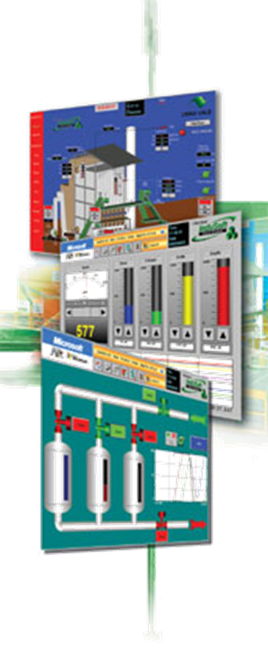
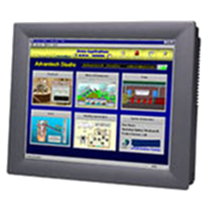
SoftPLC Web Studio
SCADA=Supervisory Control and Data Acquisition
Web Studio is a complete SCADA software product
Graphics, alarms, trends, reports, database….
Runs on any Windows environment (mobile thru Server)
Embedded Linux version (IoTView) generates HMTL5 for viewing on any browser, can run in SoftPLC
Has TagWell driver
Web Studio HMI’s
Panel-PC’s w/ Web Studio runtime pre-loaded
Many sizes/models available, including “Headless”

Slide 14
SoftPLC PAC’s
Universal Features/Functions

Slide 15
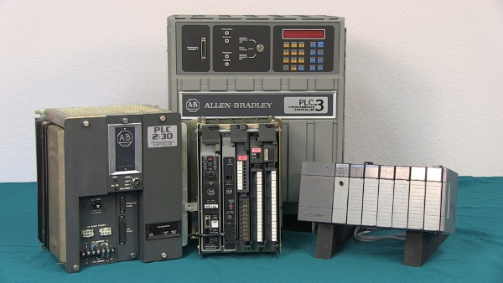
“What is a SoftPLC?”
SoftPLC is embedded control software that turns an industrial computer into an open architecture controller
First “PAC” (Programmable Automation Controller) on the market
Features of PLC’s (I/O control, PID) PLUS computers (flexibility, networking, speed)
Runs on dedicated “headless” computer (eg: no monitor, mouse…)
Modelled after Allen-Bradley PLC’s (Rockwell Automation)
~70% of installed PLC base in Americas is A-B
Gateway from A-B to other vendor’s equipment or the cloud
Provides A-B users an easy, affordable upgrade path

Slide 16
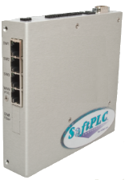
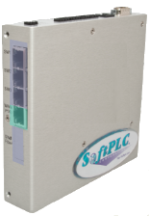
SoftPLC Functions
Managed Switch / Router
Embedded Firewall / VPN
Firmware Option

Slide 17
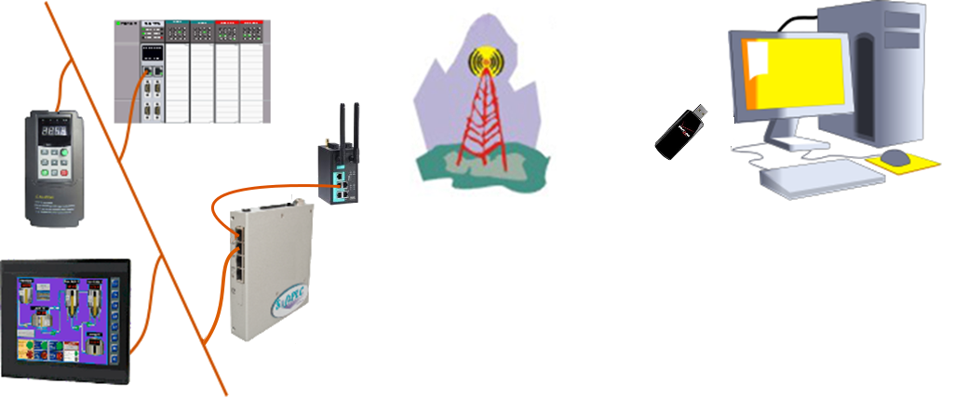
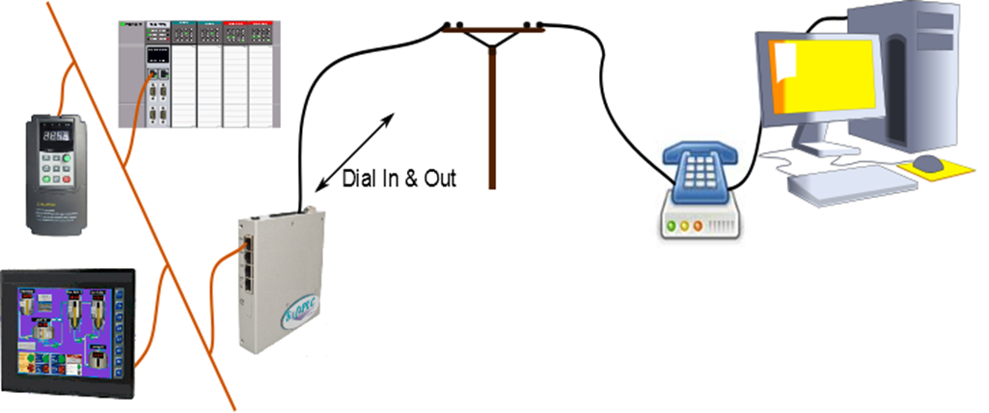
Remote Access Switch
Internal phone modem supports dial-in & -out simultaneously
With external modems, cell/satellite or other supported
Access SoftPLC logic/firmware/other files
Access any device connected to Ethernet ports
Send alarms

Slide 18
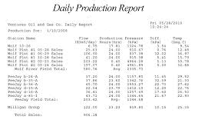
Data / Event Logger
Log to internal Compact Flash or any external disk (incl. network drives)
CSV, compressed binary or other file formats
Multiple file access options
Alarm Notification
Email / Text
Reporting
Read/Write to disk (eg: recipes, reports)
Email attachments (eg: log file, production report)

Slide 19
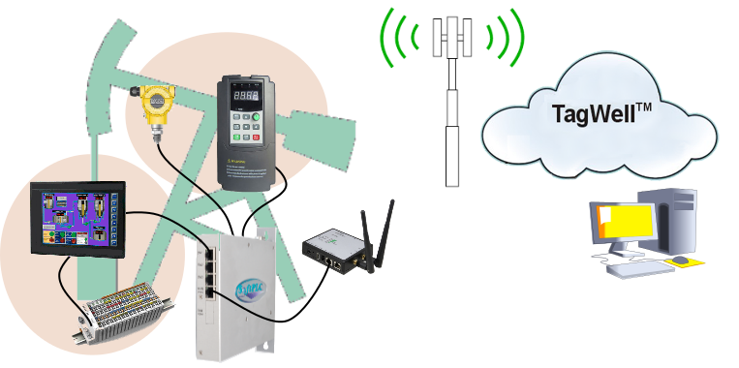
Protocol Converter / Communications Gateway
Up to 16 protocols simultaneously
No limit on data words
Example Application

Slide 20
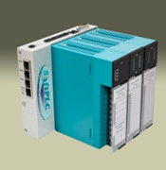
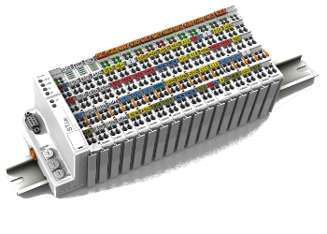
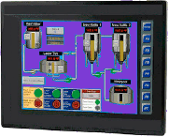
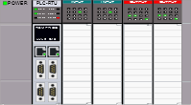
PLC / PAC / RTU
Controller logic (ladder, function blocks ….)
“Unlimited” Data Registers
I/O control over 20K points
Select from hundreds of I/O and device vendors
Communications - Multiple networks/ protocols supported
Any HMI / SCADA / DCS
Other PLCs/PACs

Slide 21
IoT - Remote Monitoring & Control via the Cloud
TagWell accessed from any SoftPLC via a free loadable function block
SoftPLC Remotes can be gateway to other vendor’s equipment and/or controllers

Slide 22
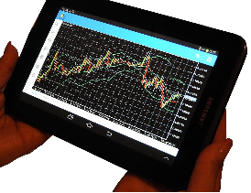
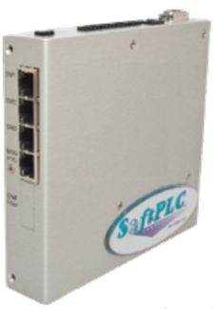
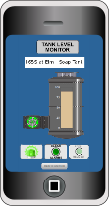
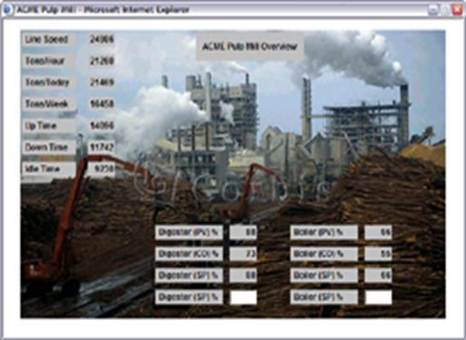
“Virtual” HMI to Web Browser
Embedded Web Studio IoTView runtime
TagWell
Embedded Web Server
Web pages can be same as in TagWell
Any Ethernet/Internet connection
Wired
WiFi / Bluetooth
Cellular
Satellite / VHF

Slide 23
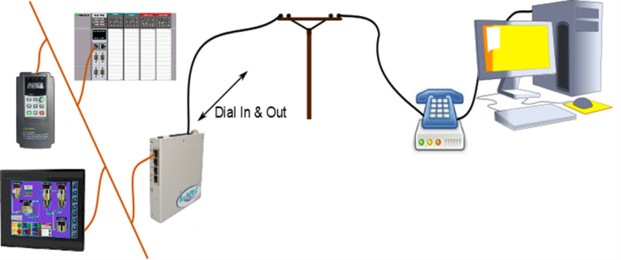
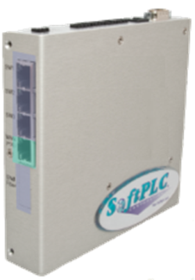
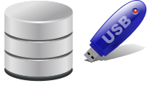
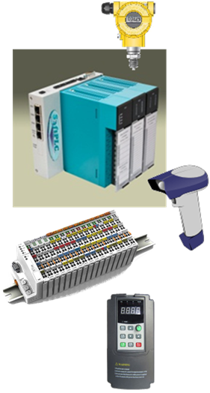
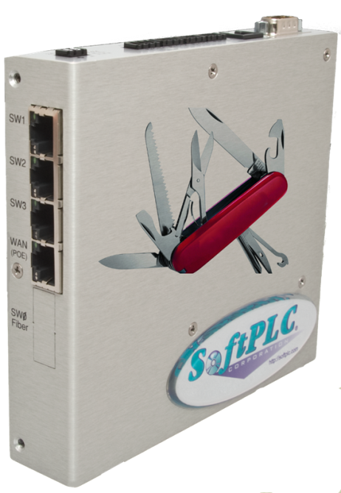
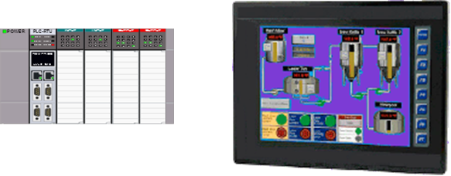

Slide 24
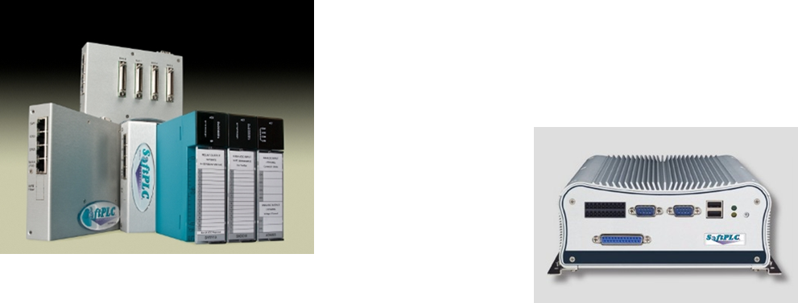
Hardware Models
For SoftPLC’s & Gateways

Slide 25
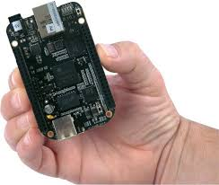
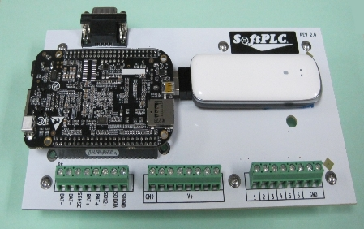
Micro SoftPLC
Small physical size
Available w/ DIN-mount enclosure or as board-level product
Extended temperature version available (-40~85oC)
Low power (ideal for battery/solar powered installations)
I/O/Network Options
USB
Ethernet (eg: ModbusTCP)
Serial (eg: Modbus)
Direct-Mount I/O boards

Slide 26
Smart SoftPLC
DIN-rail or panel mount
Built-in 4-port managed Ethernet switch
(2) IP interfaces for routing capability
(6) serial ports
(4) RS-232 ports
(1) RS-485 2-wire port (option to factory re-configure as A-B RIO/DH+)
(1) factory configurable serial RJ11 port (2/4 wire RS-485, A-B RIO, A-B DH+, CAN/J1939)
New version under development will add
(3) USB ports
Wireless / Zigbee / Bluetooth

Slide 27
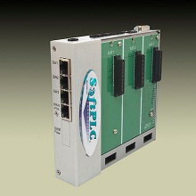
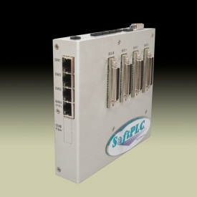
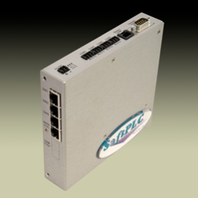
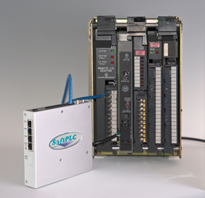
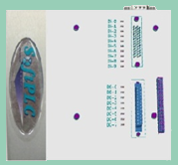
Smart SoftPLC
Selectable I/O interfaces
Local Tealware Interfaces
Backplane3 supports 3 modules mounted onto CPU
LocalPorts supports up to 12 Tealware racks
Remote I/O
Ethernet (e.g.: ModbusTCP)
Serial (e.g.: Modbus)
A-B RIO
Bus I/O via PCI-104 (e.g.: ProfiNet, CANOpen )
Local I/O Boards (under development)
Combo – 10 DI,8 DO, 6AI

Slide 28
Hardbook SoftPLC
Industrial PC’s w/ SoftPLC embedded
High end processing power
Class 1, Div 2 rating
“unlimited” options
Hundreds of 3rd party devices supported

Slide 29
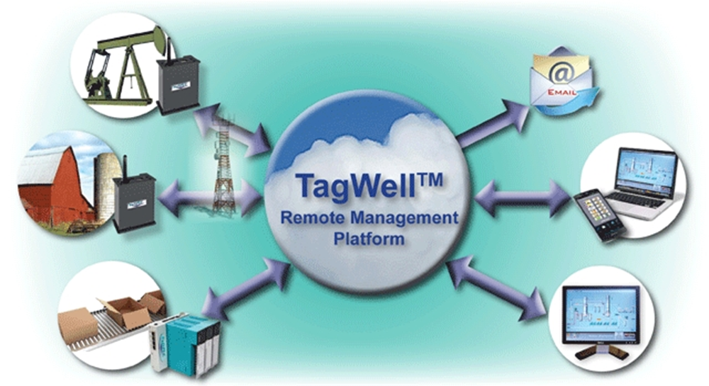
SoftPLC & TagWell
Remote system monitoring & control, data logging,
alarms via text/email, remote data access & more

Slide 30
System Components
SoftPLC Remotes – Devices that communicate to TagWell via a private subnet (ie: cellular) or public subnet.
SoftPLC Remotes can also perform I/O control, log data, communicate to PLC’s, drives, I/O and other computers, send email/text messages & more.
TagWell – A public cloud service that provides bi-directional access to and from protected remotes via the internet

Slide 31
What is TagWell?
TagWell is a powerful & configurable platform for comprehensive, scalable remote control system management
Utilizes Internet secure cloud private VPN technologies
TagWell™ provides:
A secure bi-directional access path to “things” over the Internet
An API that can be used to develop browser and web-based applications (eg: data aggregation, reports, database/SCADA interfaces)
A cache for user-selected “interesting” data from Remotes

Slide 32
TagWell Features/Benefits
Optimized communication scheme reduces bandwidth req’ts
Design maximizes delivery reliability and minimizes packet size
Remotes determine when to send data & which data to send
Event driven (Report status changes/values outside of user-defined alarm bands)
Time driven (Report based on time interval)
Any process condition/event can change reporting content/frequency
Reporting by exception further minimizes bandwidth req’ts
Architecture dynamically grows with demand
No limit on number of remotes
No IT expertise/interaction req’d (eg: firewalls, VPNs, SIM card management)

Slide 33
Intelligent SoftPLC Remotes
Built-in protocols (interface to sensors, I/O, other vendor’s RTU/PLC, drives, flow meters, etc.)
Logic functions (I/O control, calculations & more)
Alarm notification & report generation (email/text messages)
Data Logging (flexible file format, location, transfer methods)
Bi-Directional communications (remote monitoring/control, file xfer)
Remote to remote messaging (direct serial/ethernet, WiFi/Zigbee, or through TagWell cloud)
Embedded “virtual” HMI (web server or IoTView to any browser)
Embedded firewall (layered security for local access protection)

Slide 34
Data Access
SoftPLC Remotes can use any SMTP server to send email or text messages (eg: alarms, status or production reports)
TagWell data can be accessed via password protected http
Web pages in TagWell can be used as a user interface
User applications written using the TagWell API can communicate to databases/SCADA systems, transfer files, generate reports, and more
SoftPLC Corp can help develop and/or host these custom applications in the cloud
Web Studio applications via the TagWell driver

Slide 35
Web Studio + TagWell
Web Studio’s TagWell driver provides read/write access to SoftPLC Remotes on a private subnet
Communication to each Remote can be individually configured
User customizable applications (vs. fixed/limited dashboards of many other cloud solutions)
All Web Studio functions available (historical trending, reporting, alarm history, and much more)
Using TagWell API and Web Studio scripting, advanced and customized functions possible (eg: file transfers)
Advantages vs traditional SCADA solutions
Reduced cost in cellular applications
Increased data update/throughput rates

Slide 36
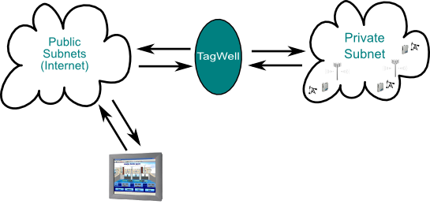
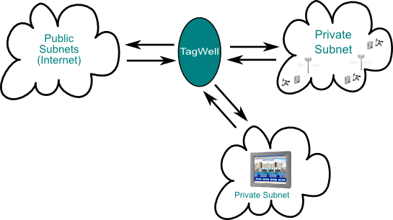
Configurations

Slide 37
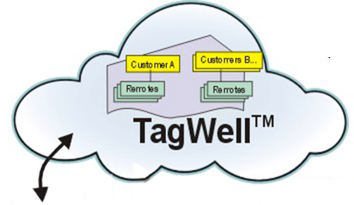
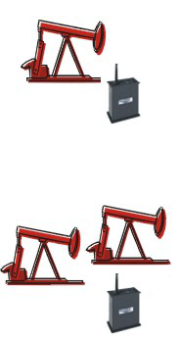
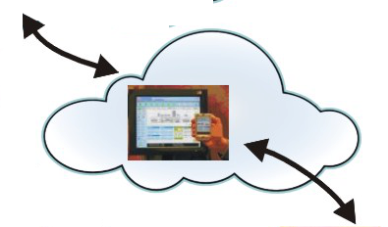
Application Example Oil Field RTU & SCADA

Slide 38
“Great Fit” applications

Slide 39
Facility Control/Monitoring
Automated Control System w/ Remote Manual Override
Asset protection (eg: water shut-off, lock upon certain events)
Schedule maintained via web page (eg: lights, locks)
Alarms/Notifications
Maintenance items (eg: garbage, supplies)
Events (eg: water leak, septic overflow, freeze, break-in)

Slide 40
Vehicle Mounted Systems
Vibration/extreme temperatures
HMI fragile/high cost – browser interface superior in these applications
GPS Tracking
Reduce Logistics Cost/Downtime
Remote alarm notification
Remote access
Data Logging/SCADA

Slide 41
Mobile Remediation Process Control System
SoftPLC controls equipment
Alarms sent via email over cellular network
Next Version…
Replace operator interface panel w/ web browser interface
TagWell connection for remote access/monitoring

Slide 42
Remote Systems
Remote monitoring, control, troubleshooting/configuration
Reduce operating costs (labor, fuel, travel)
Reduce downtime, production losses
Reduce paperwork
Reduce SCADA costs

Slide 43
Pump Off Control System
SoftPLC RTU
I/O & VFD control/interface
Local HMI via Web Studio IoTView
Writes data to TagWell every 15 min
Local data logging
Every 15 minutes
High Speed in event of certain faults
TagWell / Web Studio Cloud
Graphical Interface all wells
Script to xfer high speed log & import into database
Can change settings in any RTU
Benefits over Competitor Solutions
No HMI Reduces cost, maintenance, energy, space
More Info High Speed Data Log & Xfer
No Lost Data RTU driven comm’s
Better Dashboard Web Studio SCADA, no limits
Lower Cloud Costs RTU & Web Studio TagWell driver designs minimize bandwidth used

Slide 44
Water Utility Distributed Control System
SoftPLC’s control pump/lift stations, water towers
Alarms via text
Local HMI via embedded web pages
TagWell interface
Remote monitoring/control
Tower→Station comm’s between SoftPLC’s
System overview by district w/ individual system drill down via cloud application
Web Studio SCADA at districts & HQ
Estimated 50% savings in SCADA costs vs competitor solutions!

Slide 45
Water well usage monitoring system (AMR)
Automate currently manual system to invoice/reimburse landowners
Original design 900MHz radios, found cellular less costly
Radio tower maintenance/engineering by customer vs cell carrier
SoftPLC to collect/totalize data
Reduce # of transmissions
Retains detailed log records if needed later
System functions:
Measure flow & calculate water usage
Monitor battery health (solar powered system)
Web page for configuration/troubleshooting
TagWell interface to existing ClearSCADA software
DNP3 protocol desired for future

Slide 46
Weather / Environmental monitoring, data logging, reporting
Early warning systems, resource planning
Fire/flood, water/sewage systems input
Hazardous Manufacturing Processes
Activate alarms

Slide 47
Calculate wet bulb temp
Log water usage by time/temp threshold
Auto turn-on water if below temp threshold (option)
Text farmer temp/pump status
Create custom daily file & send to HQ
By unit, daily usage if no temp alarms
By unit, hourly usage + temp when temp near threshold

Slide 48
Remote Tank Level Monitoring
Customer sells chemicals injected into oil wells, must ensure supply
Automating previously manual system
Run pump on demand from well control system
Monitor level in tank, report daily to TagWell
Text low-low level alarms to regional managers for immediate override action
Web Studio SCADA
Gather status of all tanks from TagWell
Xfers data to existing SCADA/logistics system

Slide 49
Irrigation/Fertilization System
Log weather & moisture parameters, stored in each RTU and cloud-based database
Automatically irrigate & add fertilizer
Web pages for monitoring, manual control & setpoint changes
Alarms via text/web

Slide 50
Movable landfill temperature monitoring system
Alarm “hot spots” via email
SoftPLC logs data & generates weekly report
Data and report sent as CSV email attachment
Related applications
Landfill gas to energy
Production data on remote systems
Backup generator monitoring

Slide 51
TagWell Live Demo
SoftPLC provides an online TagWell demo
Accessing the demo (Note: Entries are case sensitive!)
http://tagwell.net/SoftPLC/
Login
user = root
password = softplc
Select Facility = Demo
Currently 3 examples designed for a smart phone interface
Demo is a SoftPLC Remote in our office on the internet
w/ advance notice we can set up the demo to temporarily send alarm emails/text messages to a particular address

Slide 52
Thanks!
http://softplc.com
info@softplc.com
1-800-SoftPLC
This presentation available for download at:
https://dl.dropboxusercontent.com/u/49694441/SoftPLC_M2M_Solutions.pptx

