Slide 1
Smart Control Systems

Slide 2
Company overview
1983
1985
1988
1993
1996
2001
2007
2009
2013
2014
2015
1st Release TOPDOC/SoftWires
Tele-Denken formed
1st Release SoftPLC
Name change to SoftPLC
Tealware I/O released
Linux Version SoftPLC
SoftPLC
Web Studio
SmartBoard released
TagWell released
Micro SoftPLC released
IoTPAC
released

Slide 3
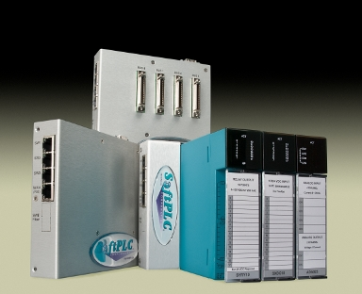
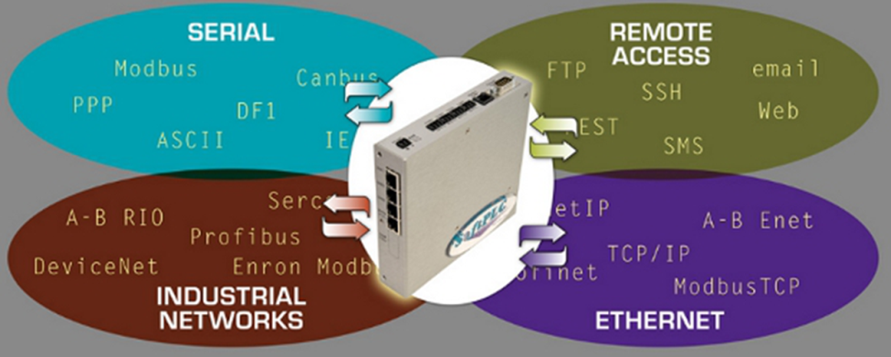
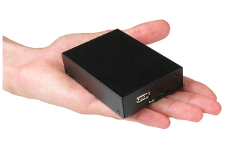
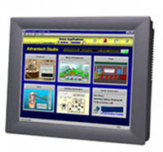
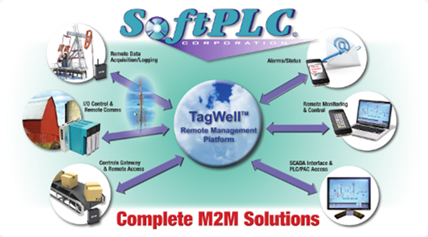
Product line

Slide 4
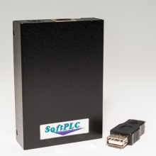
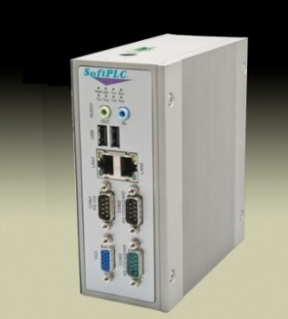
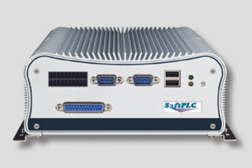
SoftPLC PAC’s

Slide 5
SoftPLC’s are not PLC’s
Better communications and data handling
Advanced features – even beyond proprietary PAC’s
Truly open architecture
SoftPLC’s are not PC-based controllers
Deterministic scan (“hard” real-time)
Online run-mode program changes
Troubleshoots like a PLC
Runs on embedded Linux, no Windows
Minimal hardware requirements, no user interaction components (e.g.: screen, keyboard/mouse, etc.)
“What is a SoftPLC?”

Slide 6
“What is a SoftPLC?”
SoftPLC® is embedded control software that turns an industrial computer into an open architecture controller
First “PAC” (Programmable Automation Controller) on the market
Features of PLC’s (I/O control, PID) PLUS computers (flexibility, networking, speed)
Deterministic scan (“hard” real-time)
Online run-mode program changes, troubleshooting like PLC
Runs on dedicated “headless” computer (e.g.: no monitor, keyboard…)
Programming/Addressing modelled after A-B PLC’s (A-B PLC “on steroids”)
Provides A-B users an easy, affordable upgrade path
>70% of installed PLC base in Americas is A-B

Slide 7
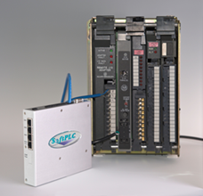
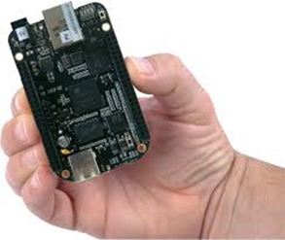
Hardware Models
Smart SoftPLC
Hardbook SoftPLC
Micro SoftPLC

Slide 8
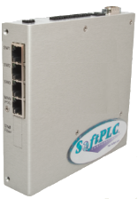
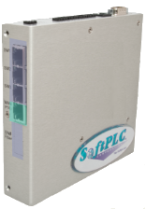
Standard SoftPLC Features
Managed Switch / Router
3 LAN, 1 WAN w/ PoE
Fiber option on LAN
Embedded Firewall / VPN
Firmware Option

Slide 9
Remote Access Switch via traditional phone lines
Access any device connected to Smart Ethernet ports
Send alarms
Supports dial-in and dial-out simultaneously
With external modem, cell/satellite or other remote communications supported

Slide 10
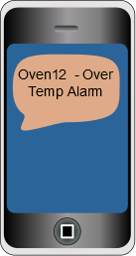
Data / Event Logger
Log to internal Compact Flash or any external disk (including network drives)
CSV, compressed binary or other file formats
Alarm Notification
Email / Text

Slide 11
Protocol Converter / Communications Gateway
Up to 16 protocols simultaneously
No limit on data words

Slide 12
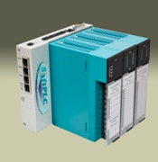
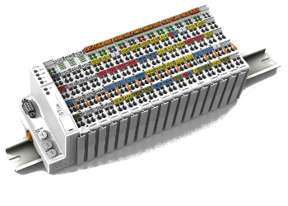
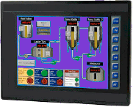
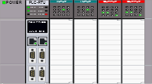
PLC / PAC
Controller logic (ladder, function blocks ….) “unlimited”
I/O control over 20K points
Select from hundreds of I/O and device vendors
Communications - Multiple networks/ protocols supported
Any HMI / SCADA / DCS
Other PLCs/PACs

Slide 13
IoT - Remote Monitoring & Control via the Cloud
TagWell is a free loadable function block in every SoftPLC
SoftPLC can be a Gateway to other vendor’s equipment
SoftPLC PAC’s can do control & provide direct link to cloud

Slide 14
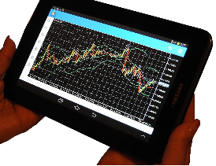
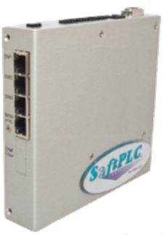
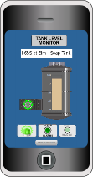
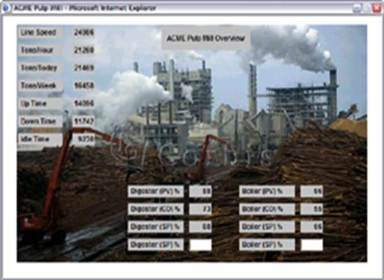
Virtual HMI to Web Browser
Embedded Web Server
IoT View
Any Ethernet connection
Wired
Wireless/Bluetooth
Internet

Slide 15
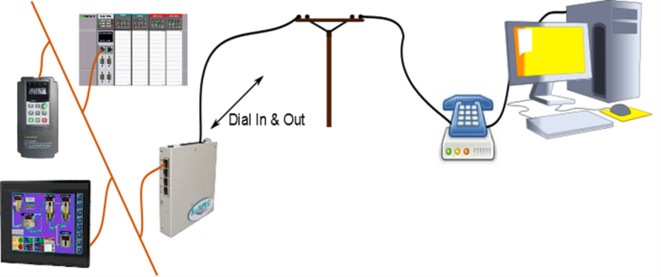
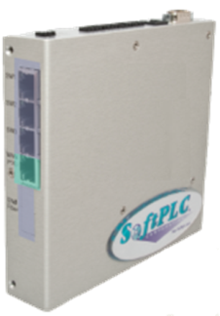
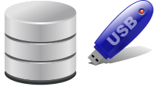
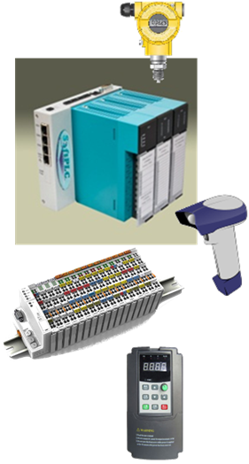
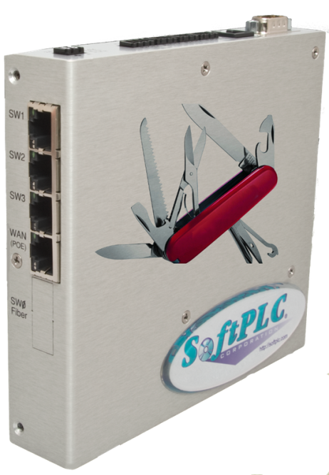
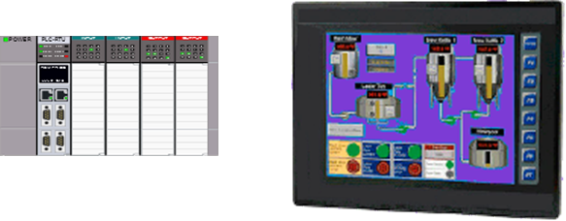

Slide 16
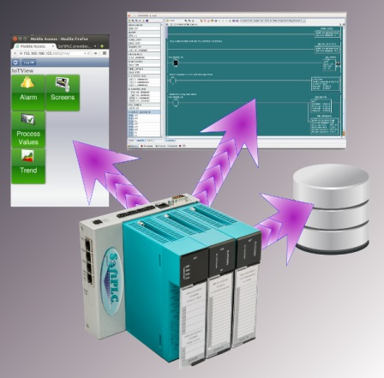
IoTPAC = SoftPLC + IoTView

Slide 17
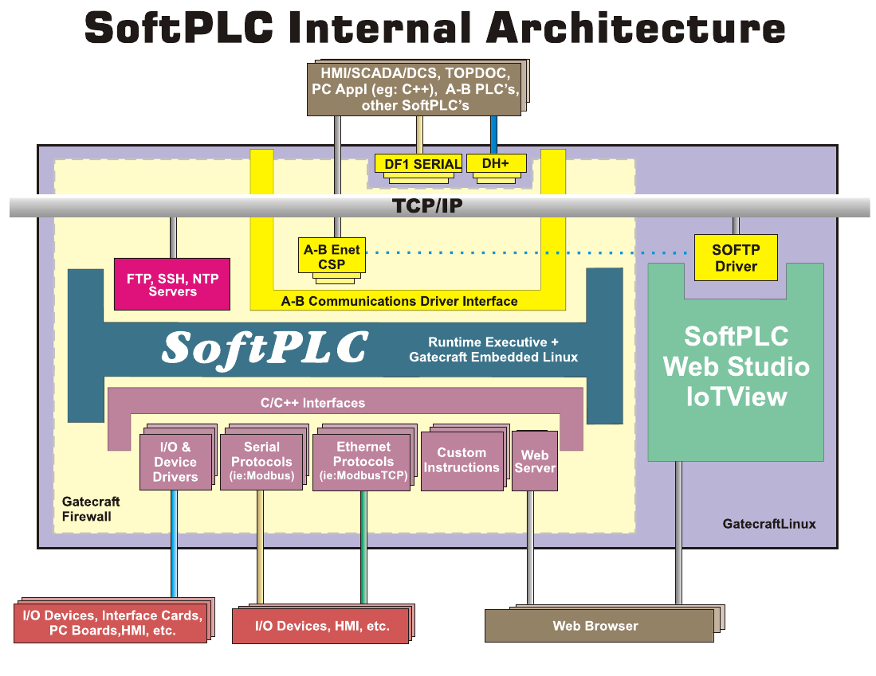
Gatecraft Linux

Slide 18
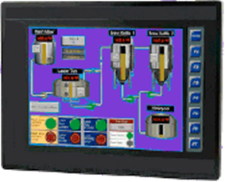
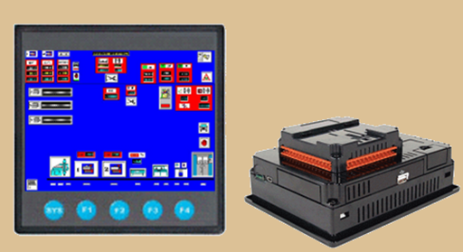
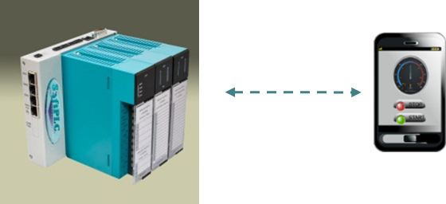
Automation Configurations
Separate PLC + HMI
Combined PLC + HMI
Combined PLC + Virtual HMI

Slide 19
Compare Configurations
Function | Separate | Combined Hardware | Combined/Virtual
Cost
App Applicability
HMI Features
PLC Features
Maintenance Cost
Physical Size
Flexibility
Remote Access
Ease of Develop.
Energy Usage

Slide 20
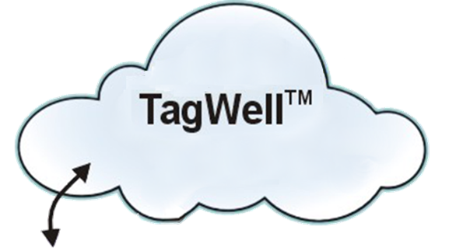
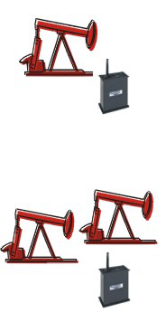
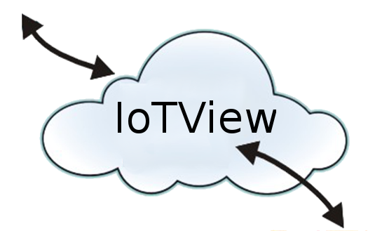
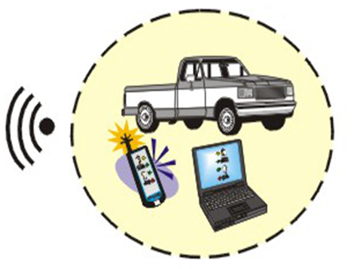
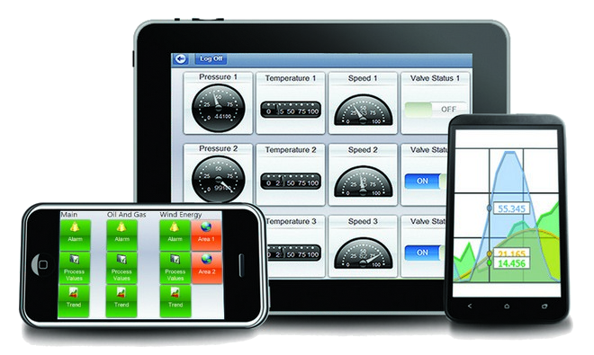

Slide 21
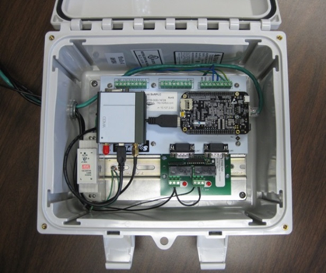
Example Remote System

Slide 22
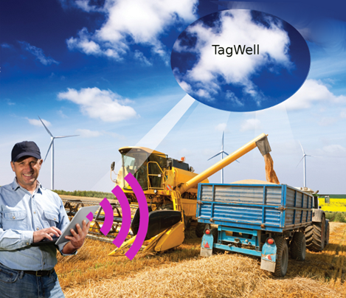
IoTPAC “great fit” applications

Slide 23
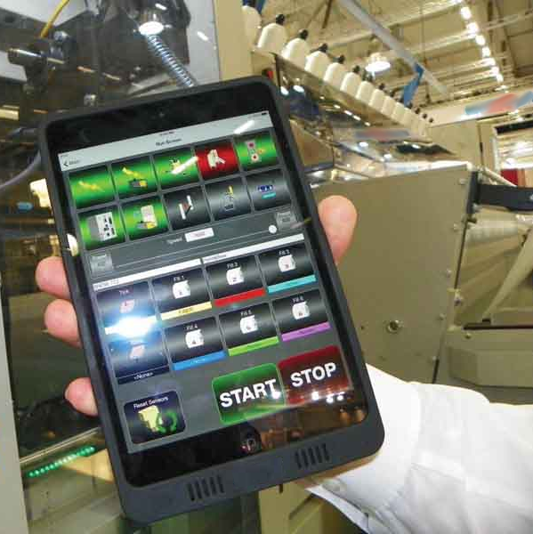
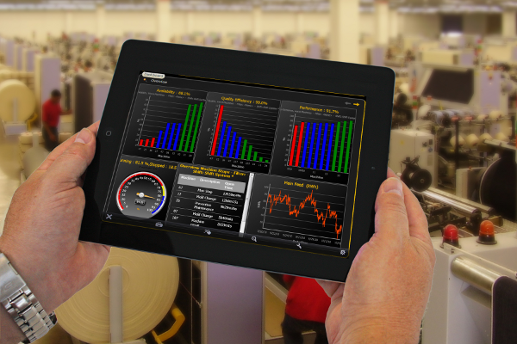
In-Plant “unattended” machines
Machines that need HMI only to load/start job, troubleshooting, etc.
Monitor/control any machine on same interface device from anywhere in the factory or remotely (if PLC is on intranet/internet)
Reduce cost, control cabinet size, maintenance
Increase worker mobility / efficiency

Slide 24
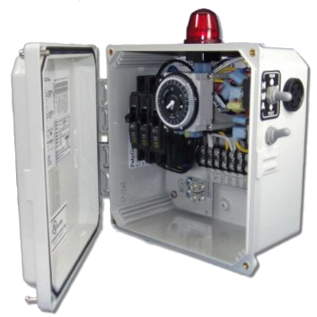
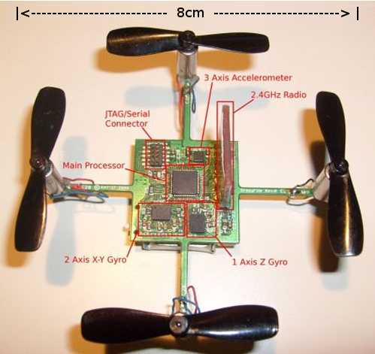
Low cost systems
On-board HMI cost not competitively possible, virtual HMI provides features at very low cost
Small, embedded systems
No physical space for on-board HMI
On-board HMI not suitable for application

Slide 25
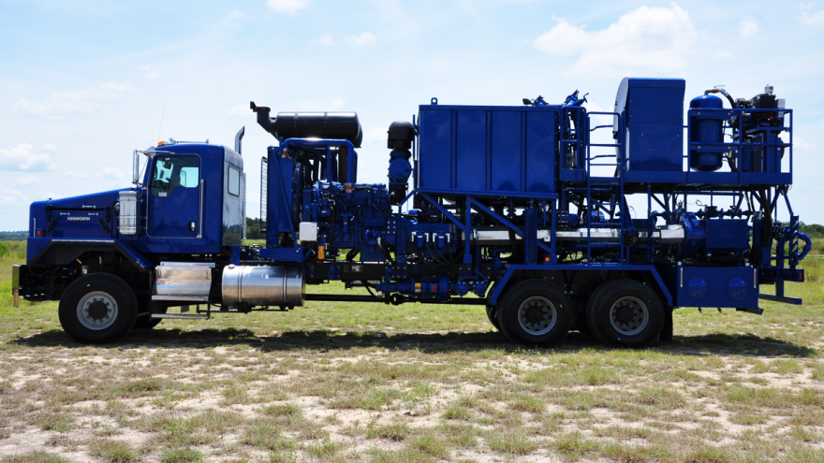
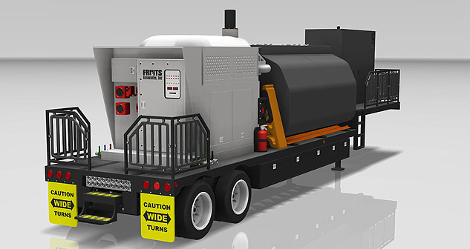
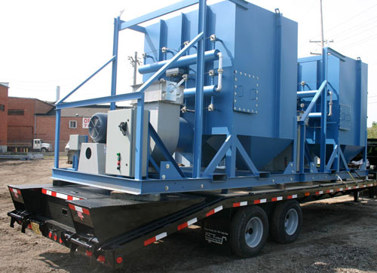
Vehicle mounted systems
Vibration/extreme temperatures dictate more expensive monitor - IoTPAC reduces this cost by off-loading visual to portable browser, “throw-away” PC

Slide 26
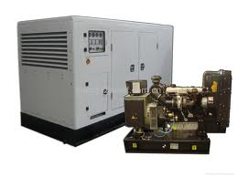
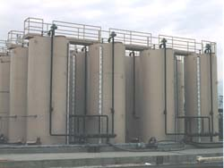
Remote Systems
Remote or unattended systems often only need local visual component during troubleshooting/configuration
Virtual solution reduces hardware cost, physical size
Eliminates touchscreen – often most fragile component of system
HMI and operator can be outside hazardous zone
Logging/alarming/data acquisition can be done by IoTPAC and/or via cloud interface

Slide 27
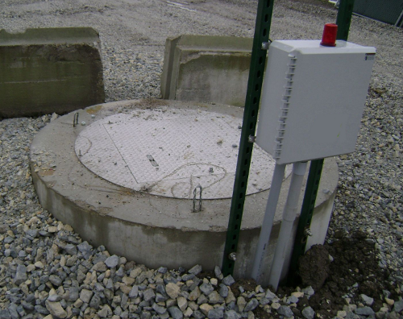
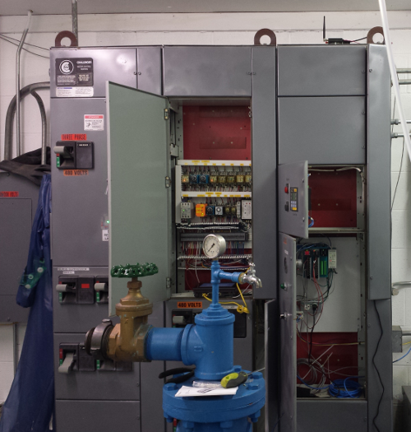
Remote Systems
HMI needed for setup/maintenance only
TagWell cloud provides SCADA interface

Slide 28
Remote Systems
Local interface not always necessary/desired

Slide 29
Thanks!
http://softplc.com
info@softplc.com
1-800-SoftPLC
512-264-8390

